Slide 1
MultiMod: Systems biology to individualize medication
Fredrik Barrenäs, Mikael Benson, Sören Bruhn, Mika Gustavsson, Hui Wang
The Centre for Individualized Medication, Linköping University Hospital, Sweden

Slide 2

Clinical problem
Variable response to treatment in common diseases
Increased suffering and cost

Slide 3
Financial problem
Staggering costs for drug development
Identification of patients that do or do not respond will improve drug development

Slide 4

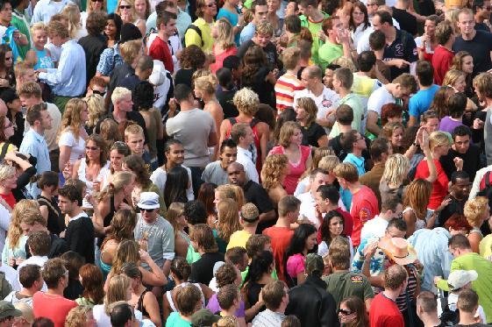
Two levels of complexity
Multiple genes
Individual variations

Slide 5
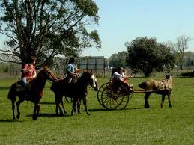

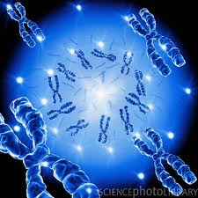
Two levels of complexity
Environment
Individual variations
Genes

Slide 6
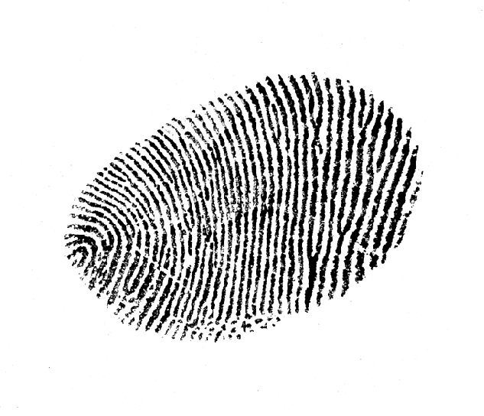
Diagnostic fingerprints?

Slide 7
Markers for personalized medication clinical routine in the next decade?
1
2
4
3

Slide 8
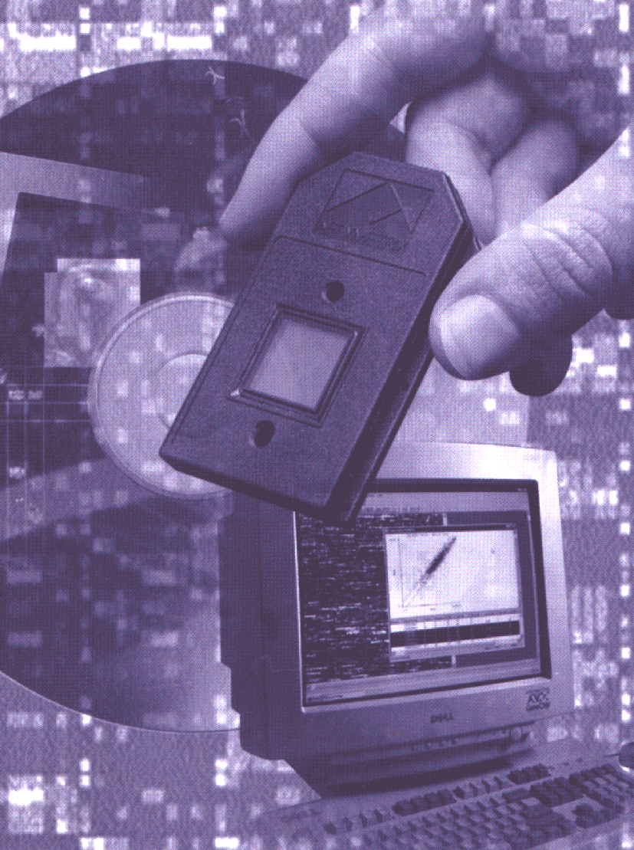
Microarray technology
DNA
mRNA
Protein

Slide 9
Long, long, long list of genes
Notes:
So when the computer has analyzed the results, it precents the data as a spredcheat with more than 6000 rows. It might look somthing like this. And now the hardes part of the project starts. To try to make any sence out of this mess
To be able to get trough this wall of information we use bioinformtic software to select the genes that show regulation. By this way we are usually down to mabe a coupple hundered genes.
In the next step we performe database and litterature searches to try to group the genes even further and try to understand what is happening to the cell.

Slide 10
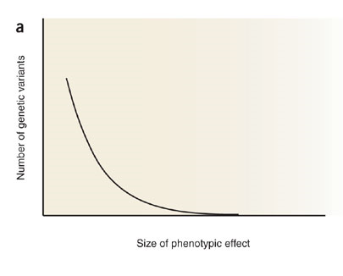
Many genes with small effects - combinations
Aitman et al. Nature Genetics, 2007

Slide 11
Do different complex systems have common properties?
2 April 1999
"Complex Systems"
Vol. 284 (#5411)

Slide 12
26 September 2003
"Networks in Biology"
Vol. 301 (#5641)

Slide 13
Networks to find correct combinations?

Slide 14
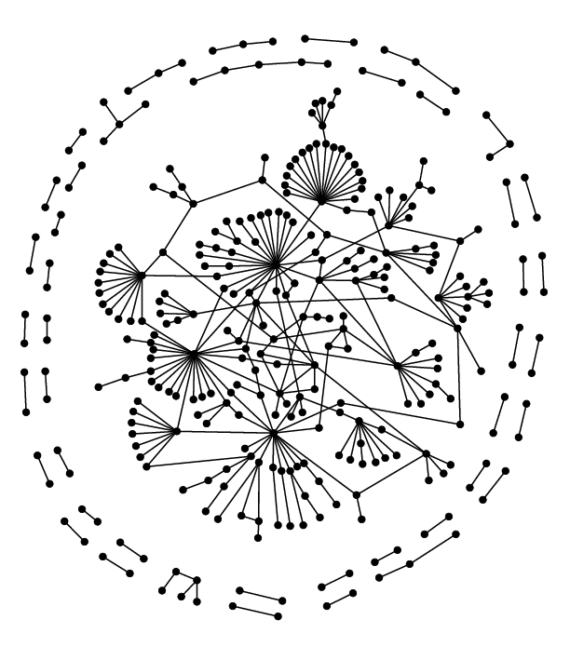
Biological networks are modular

Slide 15
Advantages of network modules
Provide overview of disease mechanisms
  Pedicini et al. Plos Comp Bio 2010
Can be used to find diagnostic markers
  Benson et al. J Allergy Clin Immunol 2006, Alzheimer’s disease, Ray et al. Nature Med 2007

Slide 16
Seasonal allergic rhinitis; an optimal model of complex disease
Known external cause (pollen)

Slide 17
Seasonal allergic rhinitis; an optimal model of complex disease
Known external cause (pollen)
Known disease cells
Known read-out (Th2 cytokines)

Slide 18
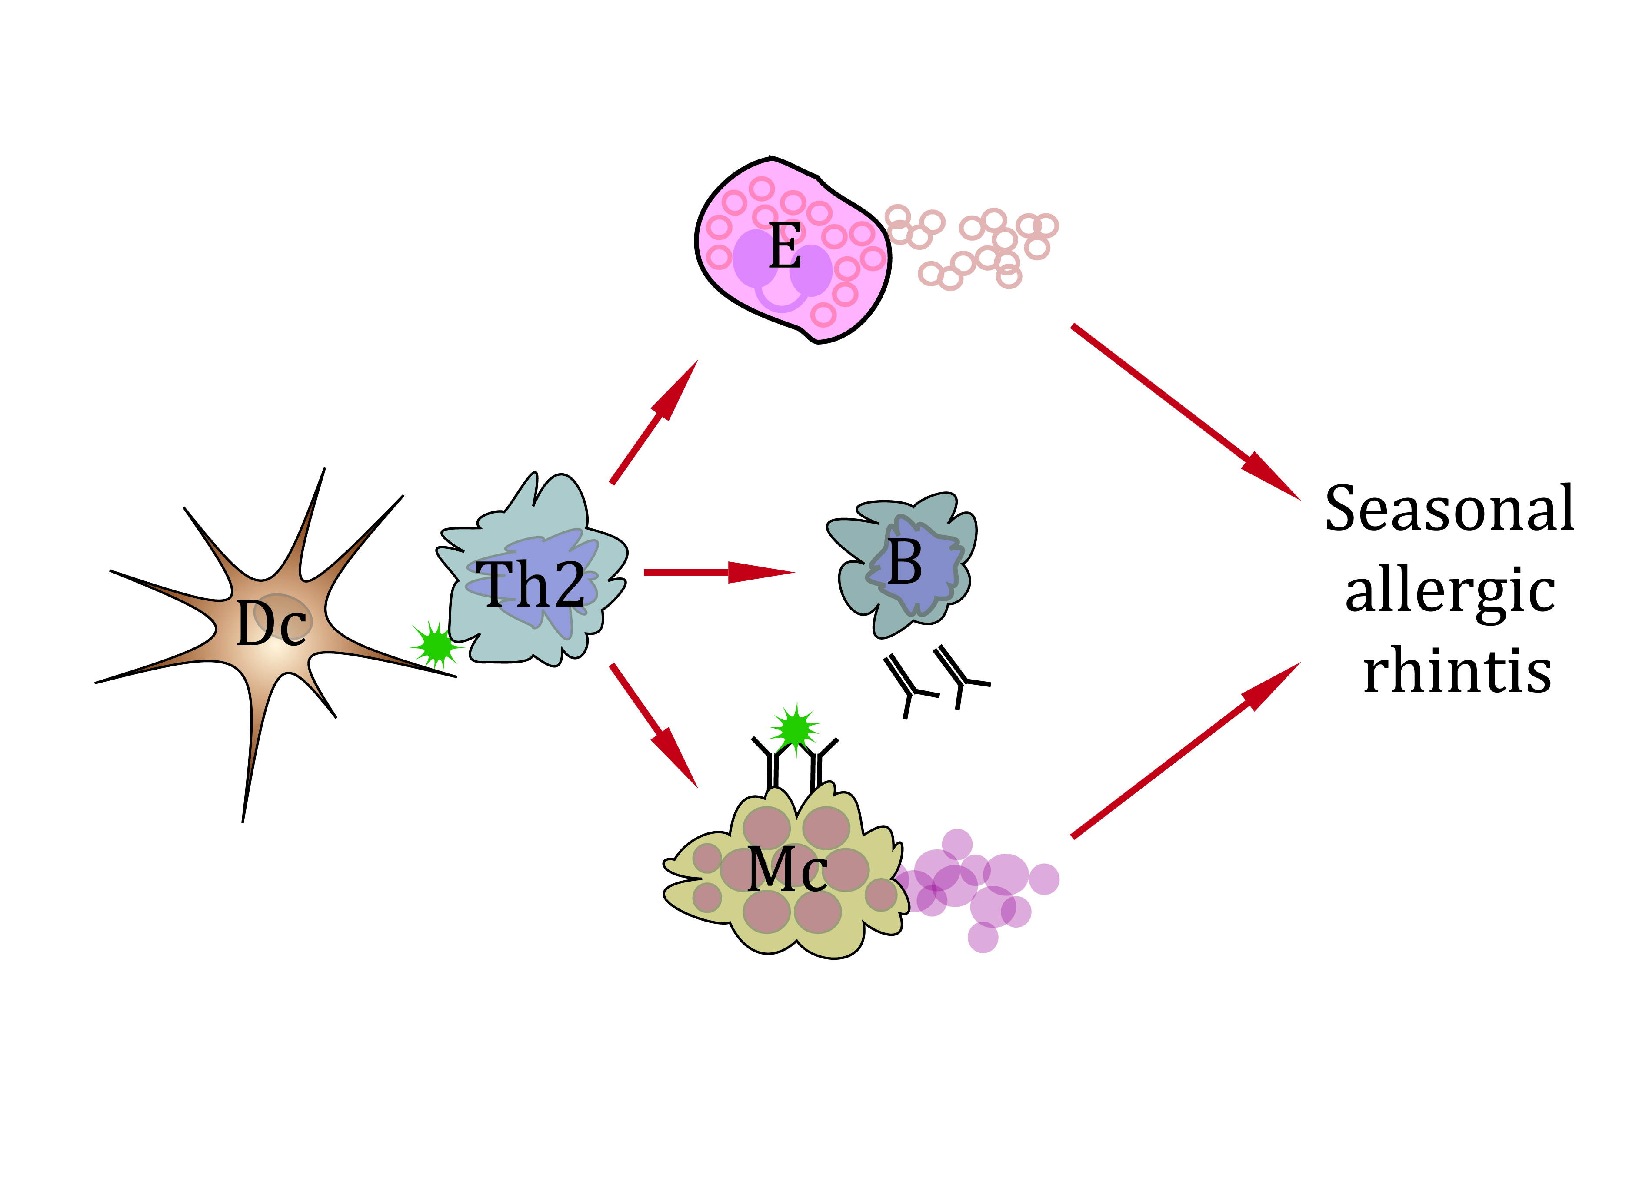
Disease model

Slide 19
Collaborative network supported by two
EU grants (ComplexDis and MultiMod)
Clinical materials: U of Barcelona, Budapest, Linköping, Padua
High-throughput genomics: U of Linköping, Oslo, Padua
Computational analyses: U of Rome, Oak Ridge Nat’l lab TN U.S.
Bioinformatics: U of Linköping, Oslo
Genetical Statistics: Imperial College, London
High-throughput RNAi: Cenix, Dresden
Experimental studies: U of Linköping, Oslo, Padua
Clinical studies: U of Linköping and Padua

Slide 20
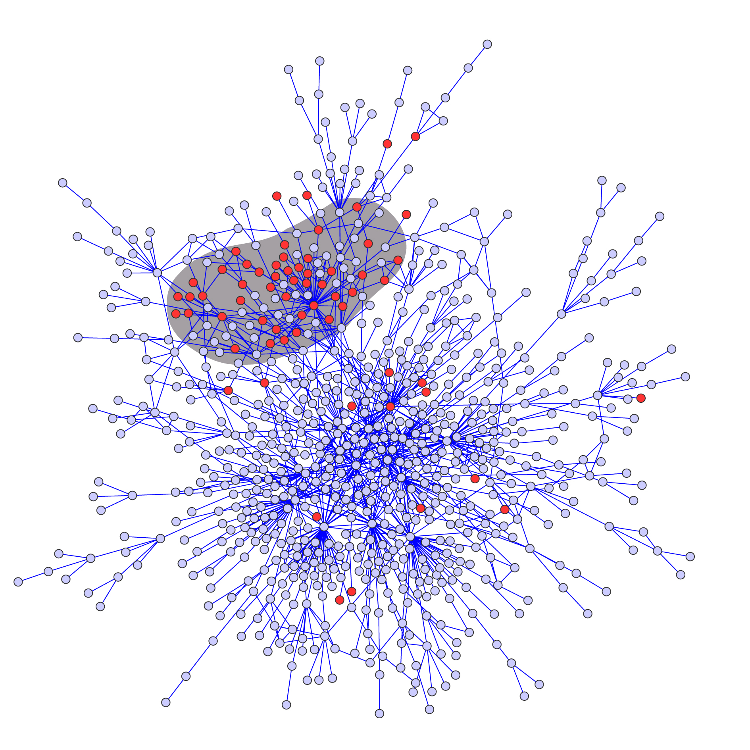
Disease modules in PPI network
Notes:
Topology
Co-localization

Slide 21
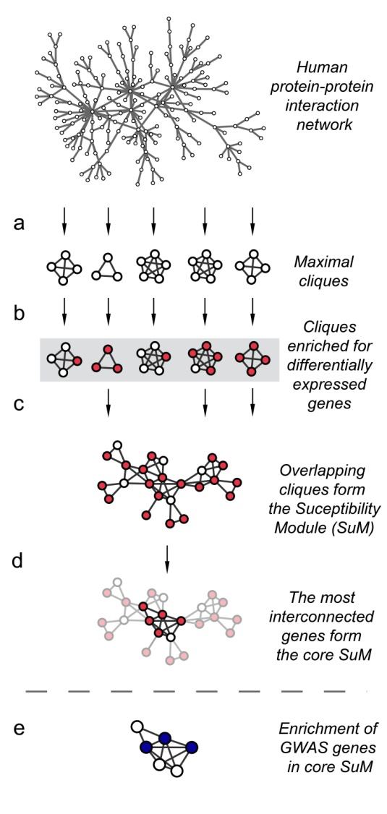
Disease modules in PPI network
Extract cliques from PPI network
Test all cliques for enrichment for DE genes
Form disease module from enriched cliques
Identify “hubs”
Test hubs for enrichment with disease-associated SNPs

Slide 22
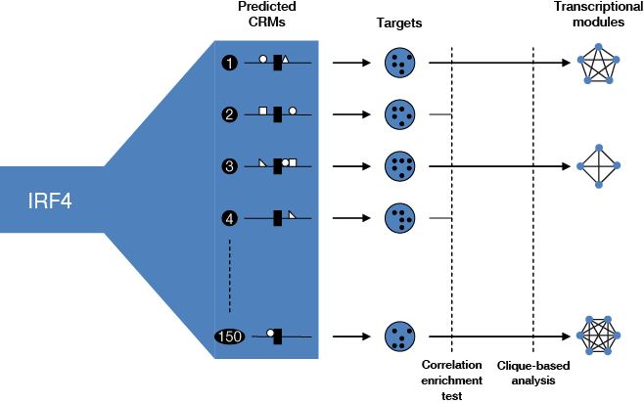
Disease module based on a key transcription factor
Bruhn et al. Allergy 2011
Notes:
Identification of IRF4 induced transcriptional modules. (A) Prediction of IRF4 containing cis-regulatory modules (CRMs) based on sequence in a 200 bp window around IRF4 binding sites.
57 CRMs within 200 bp from the IRF4 binding site defined by ChIP-on-Chip.
(B) Identification of putative target genes for each CRM. (C) Selection of modules with correlated putative target genes. (D) Clique-based analysis to extract highly correlated transcriptional modules (TMs)

Slide 23
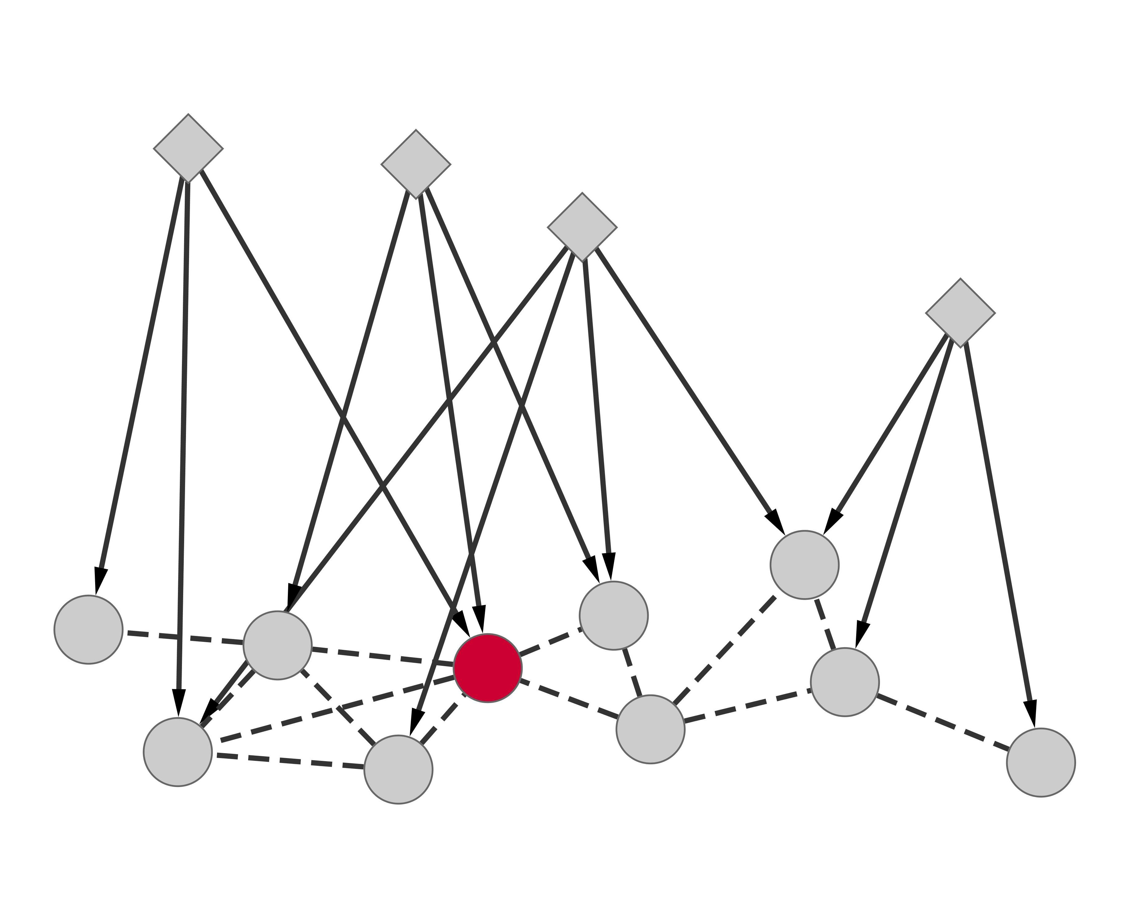
Disease module based on co-regulation by transcription factors

Slide 24
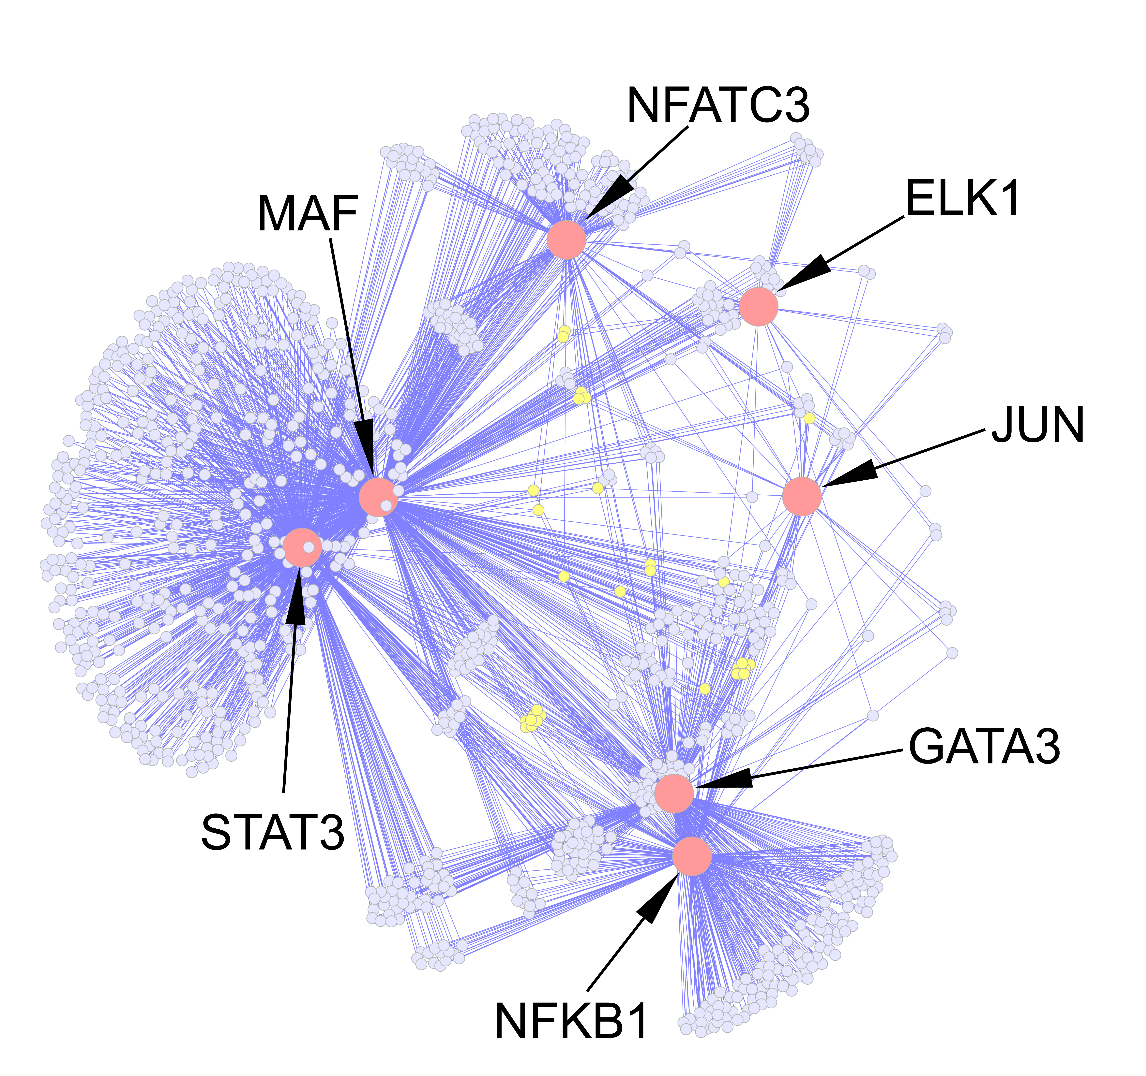
Disease module based on co-regulation by transcription factors
Knock out 30 TFs
7 TFs had effect on read-out cytokines
Perform mRNA microarrays after knock out of those 7 TFs to test if they co-regulate a module
We did find a highly interconnected module
We identified 15 novel candidate genes in the module
Knock out of these genes
11 of 15 had effect on read-out cytokines
One candidate gene validated in clinical and mouse model

Slide 25
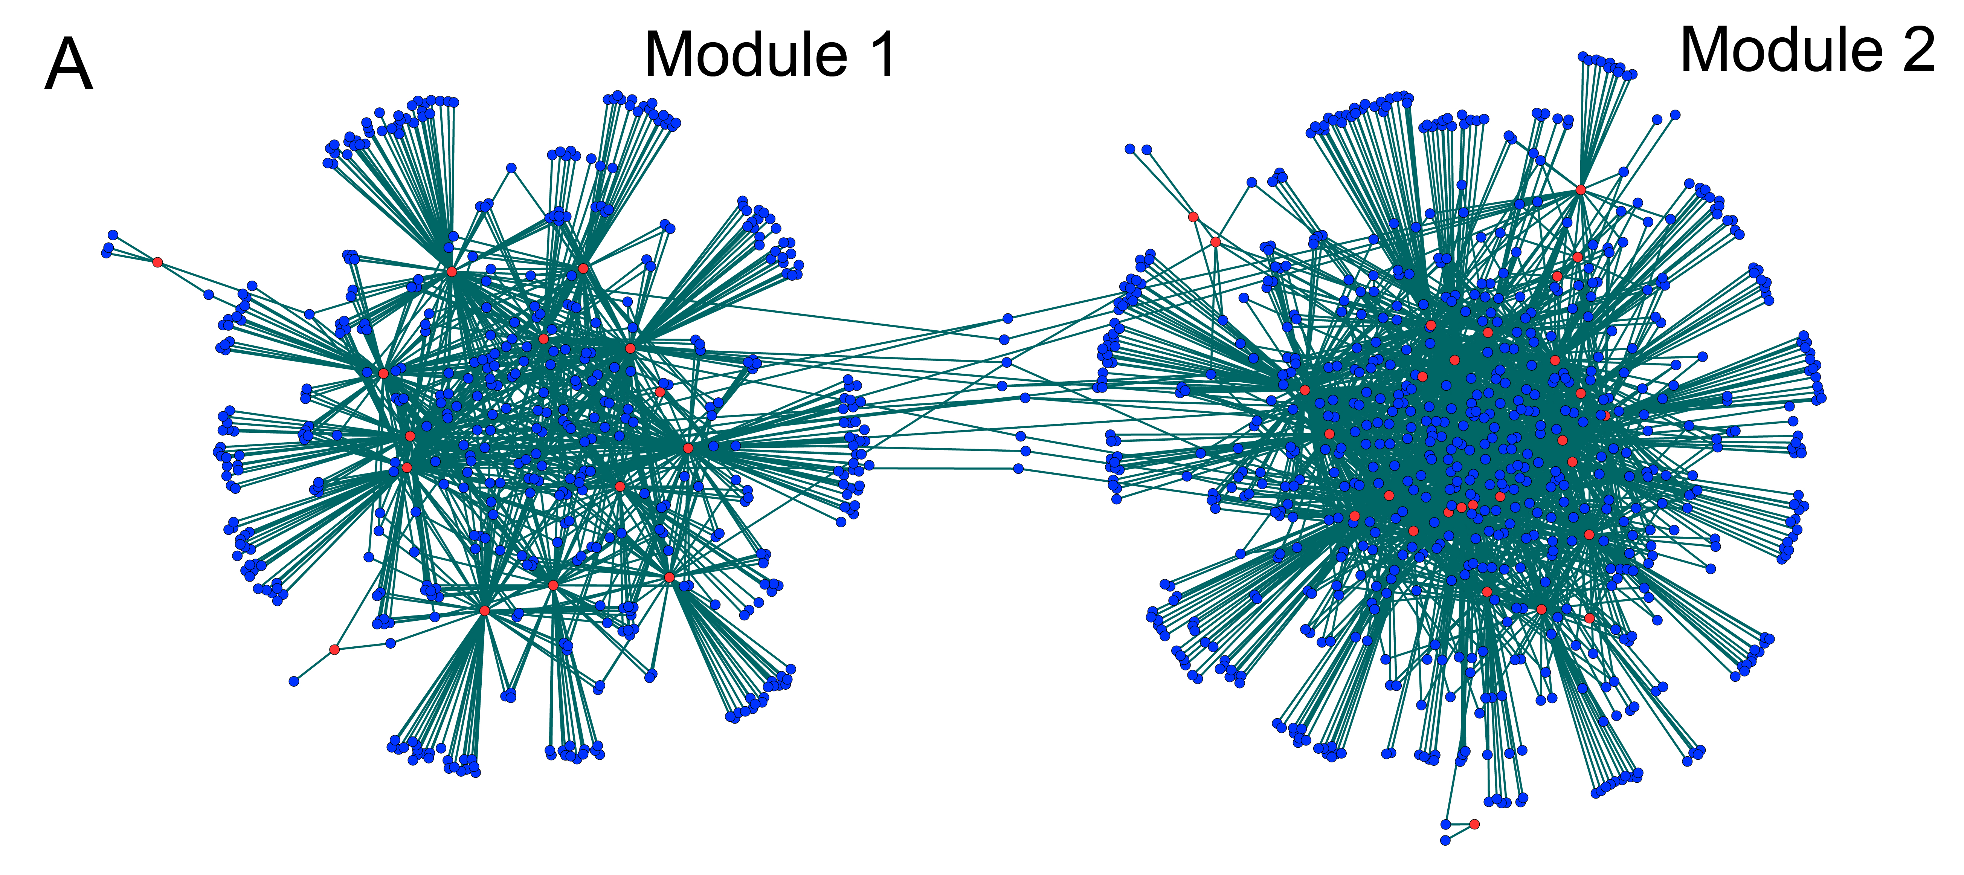
Disease module based on co-regulation by microRNAs

Slide 26
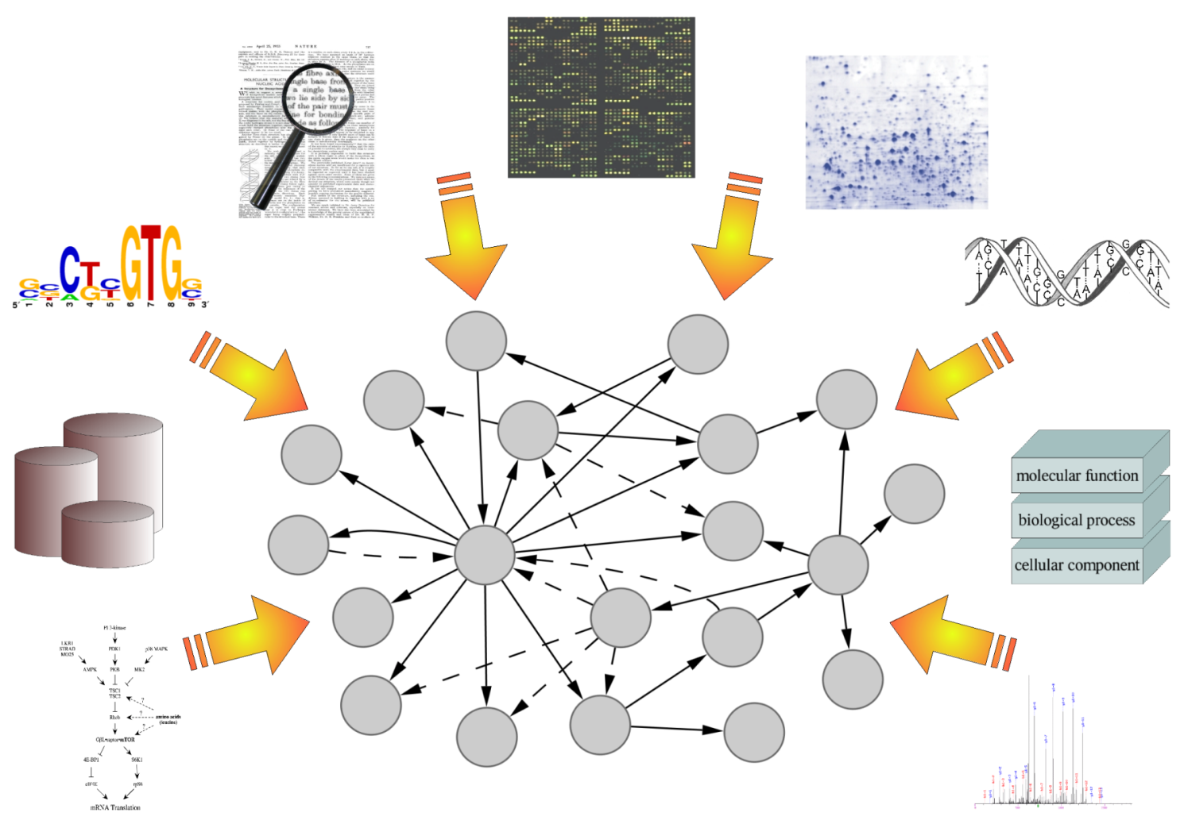
Network based analysis of genome data
Notes:
Data integration på genome skala

Slide 27
Reverse-engineering
Build up a network by finding the regulators for each gene at a time
+ “up” and “down” data
from micro array
Missing gene

Slide 28
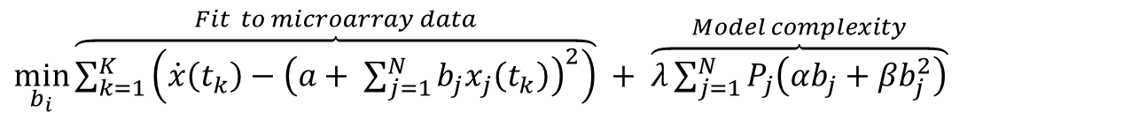
Network inference by elastic net
Minimize the sum of training error and model complexity for each gene
$\min_{b_{i}}{\overset{Fit to microarray data}{\overbrace{\sum_{k=1}^{K}{\left(\dot{x}\left(t_{k}\right)−{\left(a+ \sum_{j=1}^{N}{b_{j}x_{j}\left(t_{k}\right)}\right)}^{2}\right)}}} + \overset{Model complexity}{\overbrace{λ\sum_{j=1}^{N}{P_{j}\left(αb_{j}+βb_{j}^{2}\right)}}} }$
Advantages:
  Computationally tractable on a genome-wide scale (Zou, Hastie, Tibshirani)
  Can include multiple data sources softly and predict new experiments competitive (e.g. Gustafsson et al. PLoS ONE 2010)
  Can identify relevant hubs and modules (e.g. Gustafsson et al. in IEEE 2005, IET systems biology 2008 , ANYAS 2009)

Slide 29
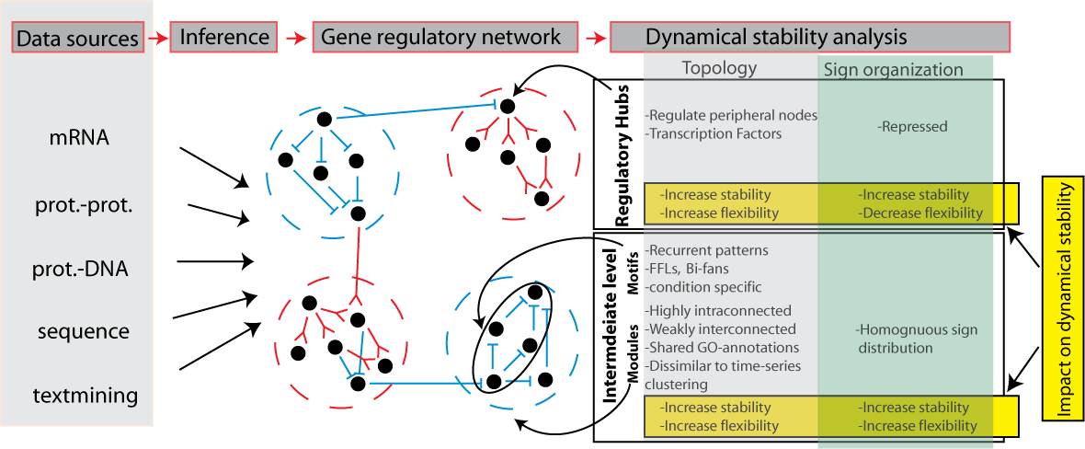
Method outline
Notes:
Knowldege from the GRN may hoepfull also lead to insights about individual markers

Slide 30
Proteomic detection of clinical markers
Wang et al. PLoS ONE 2011

Slide 31
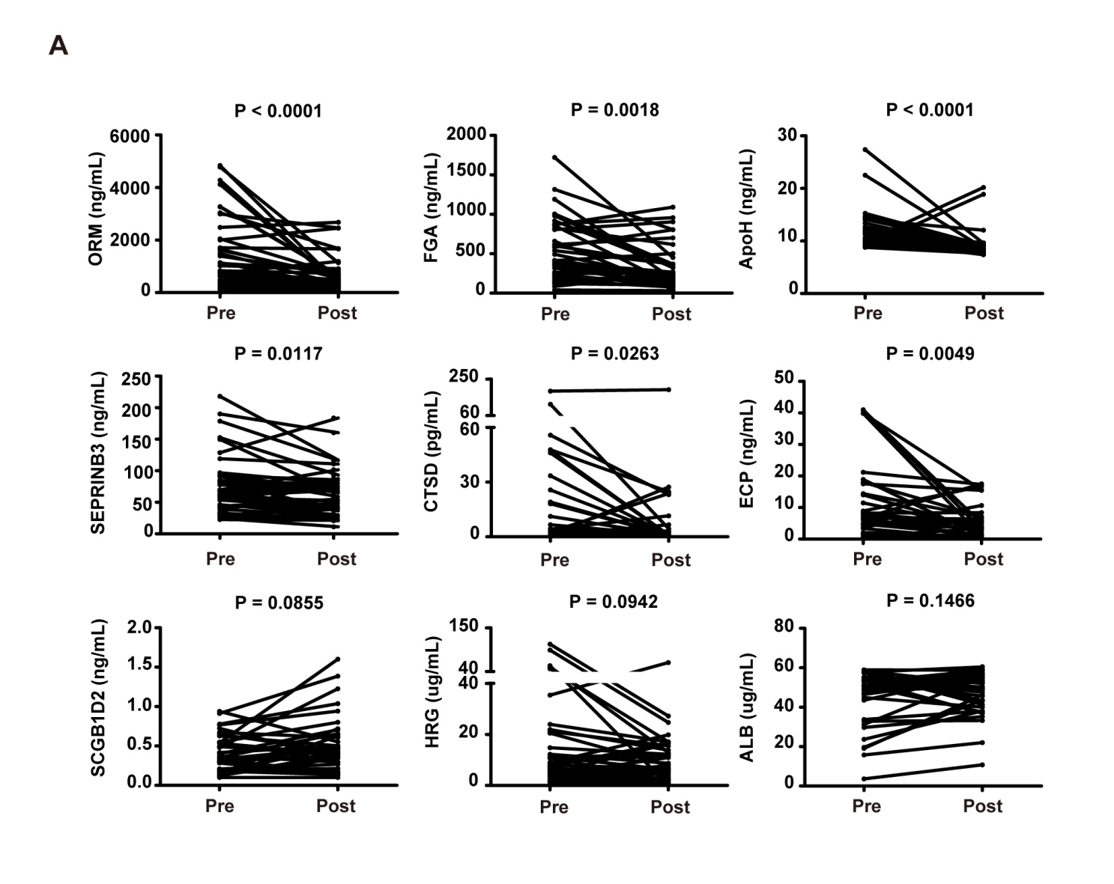
Proteomic detection of clinical markers
Wang et al. PLoS ONE 2011

Slide 32
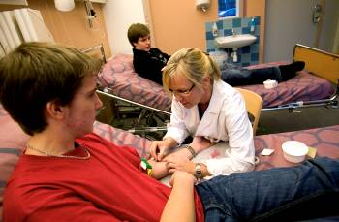
Radical change for patients and physicians

Slide 33
Summary
Allergic rhinitis is an optimal model of complex diseases
Network based analysis of high-throughput data can be used to find markers to personalize medication
The same methods likely to be applicable to all diseases: individualized medication will become routine

Slide 34
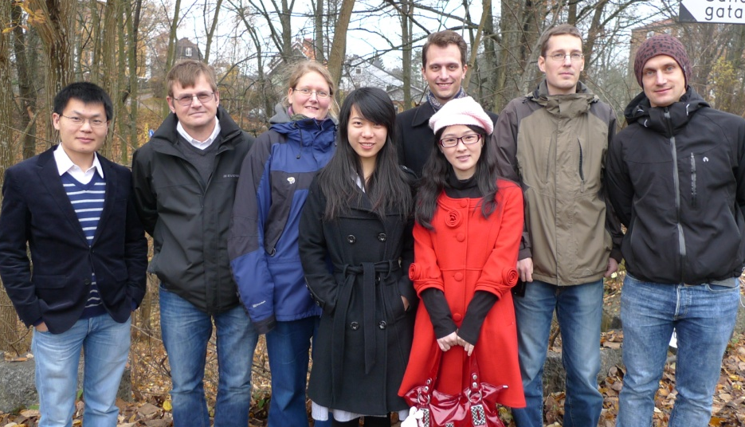


Acknowledgements
UNIVERSITY OF TENNESSEE
Michael Langston
Gary Rogers
Lachlan Coin
Alexessander Couto Alves
David Balding
IMPERIAL COLLEGE LONDON
Rebecka Jörnsten, CHALMERS UNIVERSITY OF TECHNOLOGY
Eivind Hovig
Sigve Nakken
RADIUMHOSPITALET OSLO
SWEDISH RESEARCH COUNCIL
EUROPEAN COMMISSION 7TH FRAMEWORK PROGRAMME
Birthe Sönnichsen
CENIX BIOSYSTEMS INC
Sreenivas Chavali
CAMBRIDGE UNIVERSITY

