Slide 1
An Introduction to ¹³C Metabolic flux analysis
Nicolas Sundqvist
2023-10-11

Slide 2
Metabolic Flux Analysis (MFA)
Quantitatively determine the flux configuration
Steady state
A
B
C
D
Notes:
The aim of metabolic flux analysis is to Quantitatively determine the flux configuration of a given system.
In other words it is a technique to map How different metabolites move through the system?

Slide 3
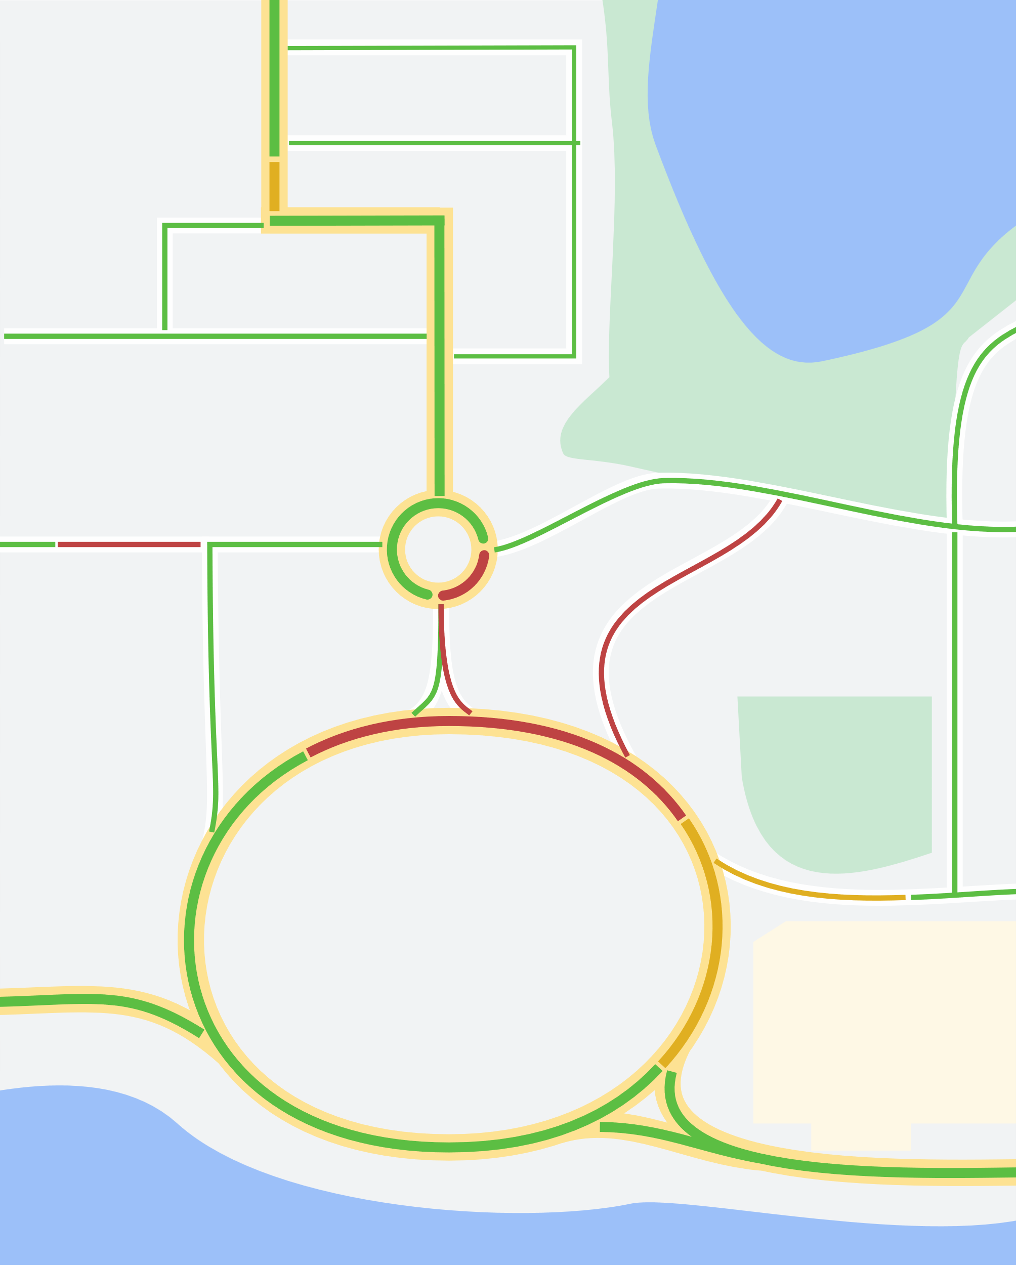
Glucose
G6P
R5P
Pentos Phosphate pathway
Glycolysis
F6P
FA
G3P
Pyr
AcCOA
OAC
Lipogenesis
Cit
Ac
Cell Work
Mal
ATP
TCA-cycle
AKG
Glutamine
Succ
Glutaminolysis

Slide 4
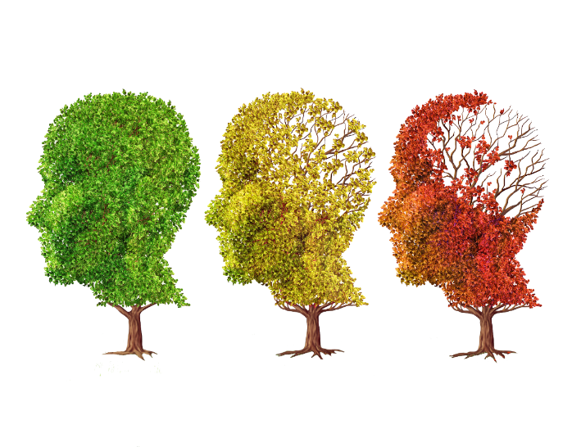
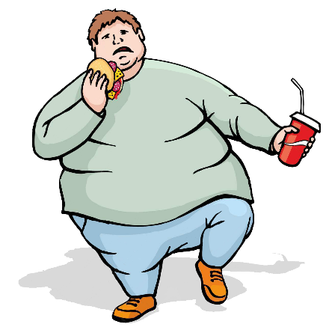
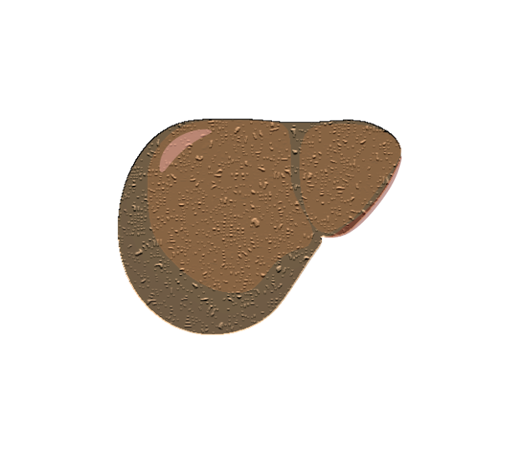
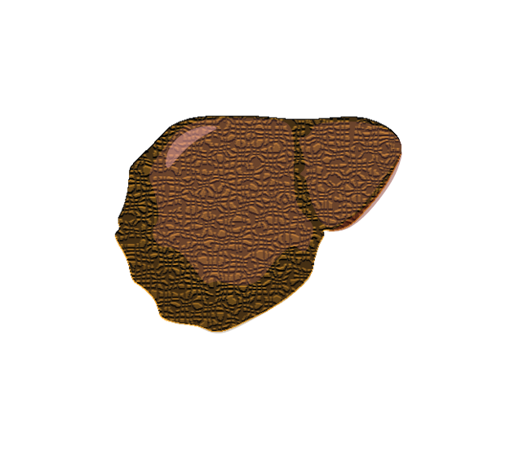
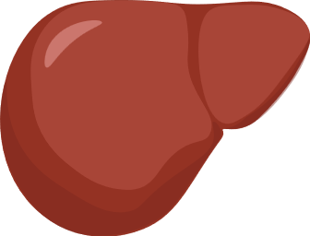
Systematic alterations of Metabolic Fluxes
T-Cell differentiation
Ageing
Metabolic
syndrome
Neurodegenerative
diseases
Normal
NAFLD
NASH

Slide 5
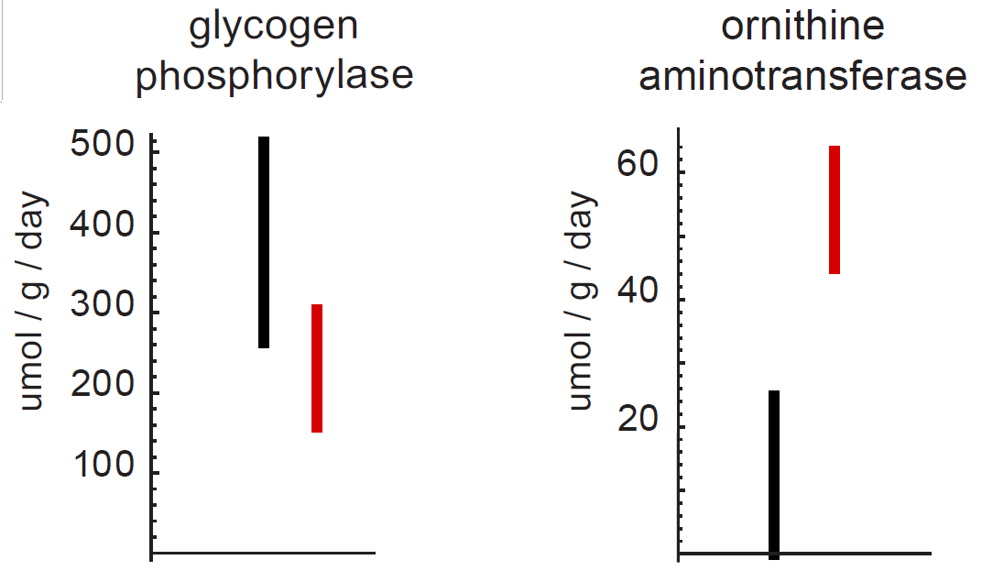
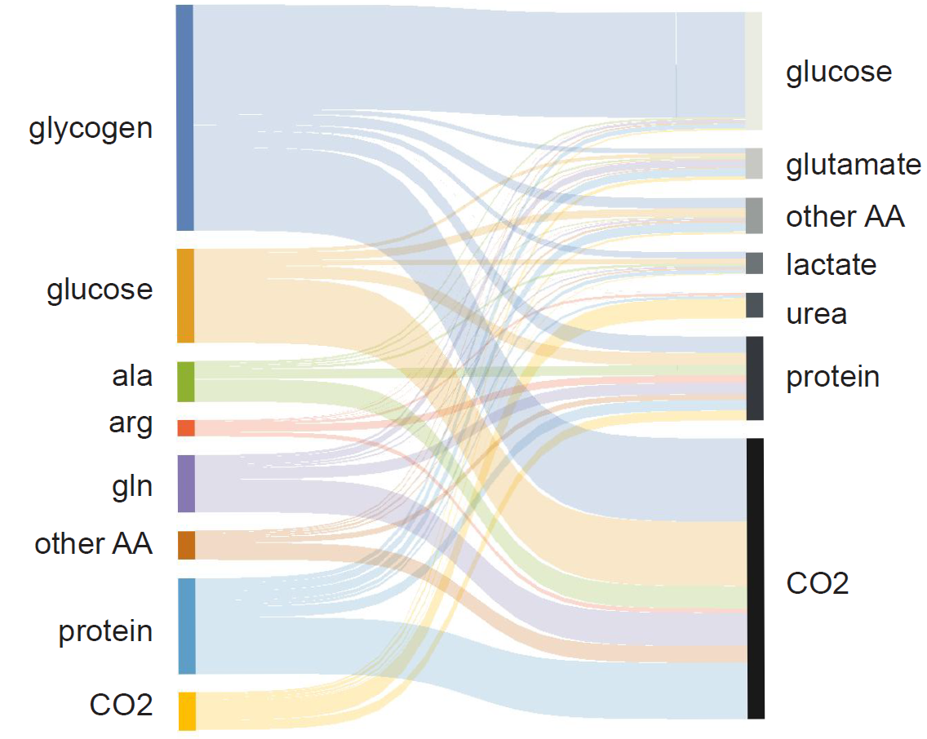
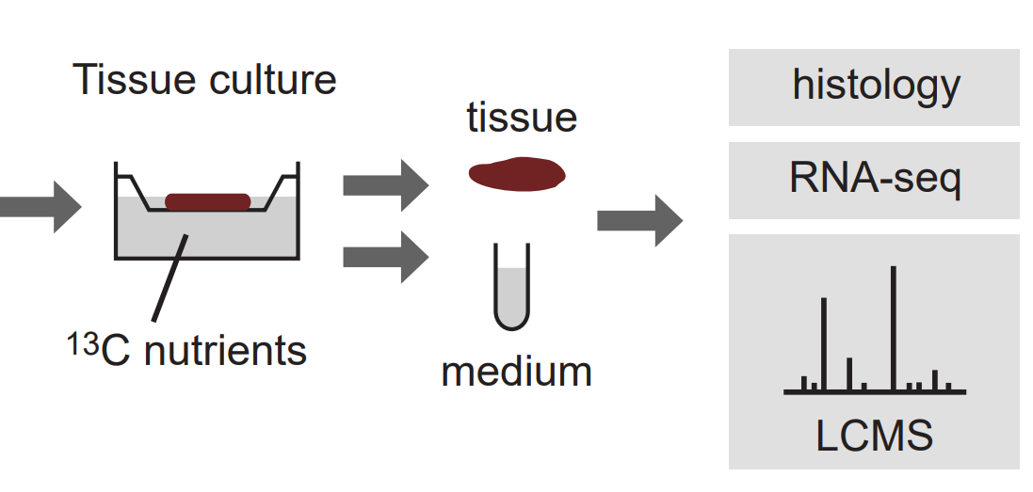
Flow of carbon
Fasted
Fed
Fed
Fasted
Normal
Grankvist N, et al, Global 13C tracing and metabolic flux analysis
of intact human liver tissue ex vivo, Submitted Nat. Metab.

Slide 6
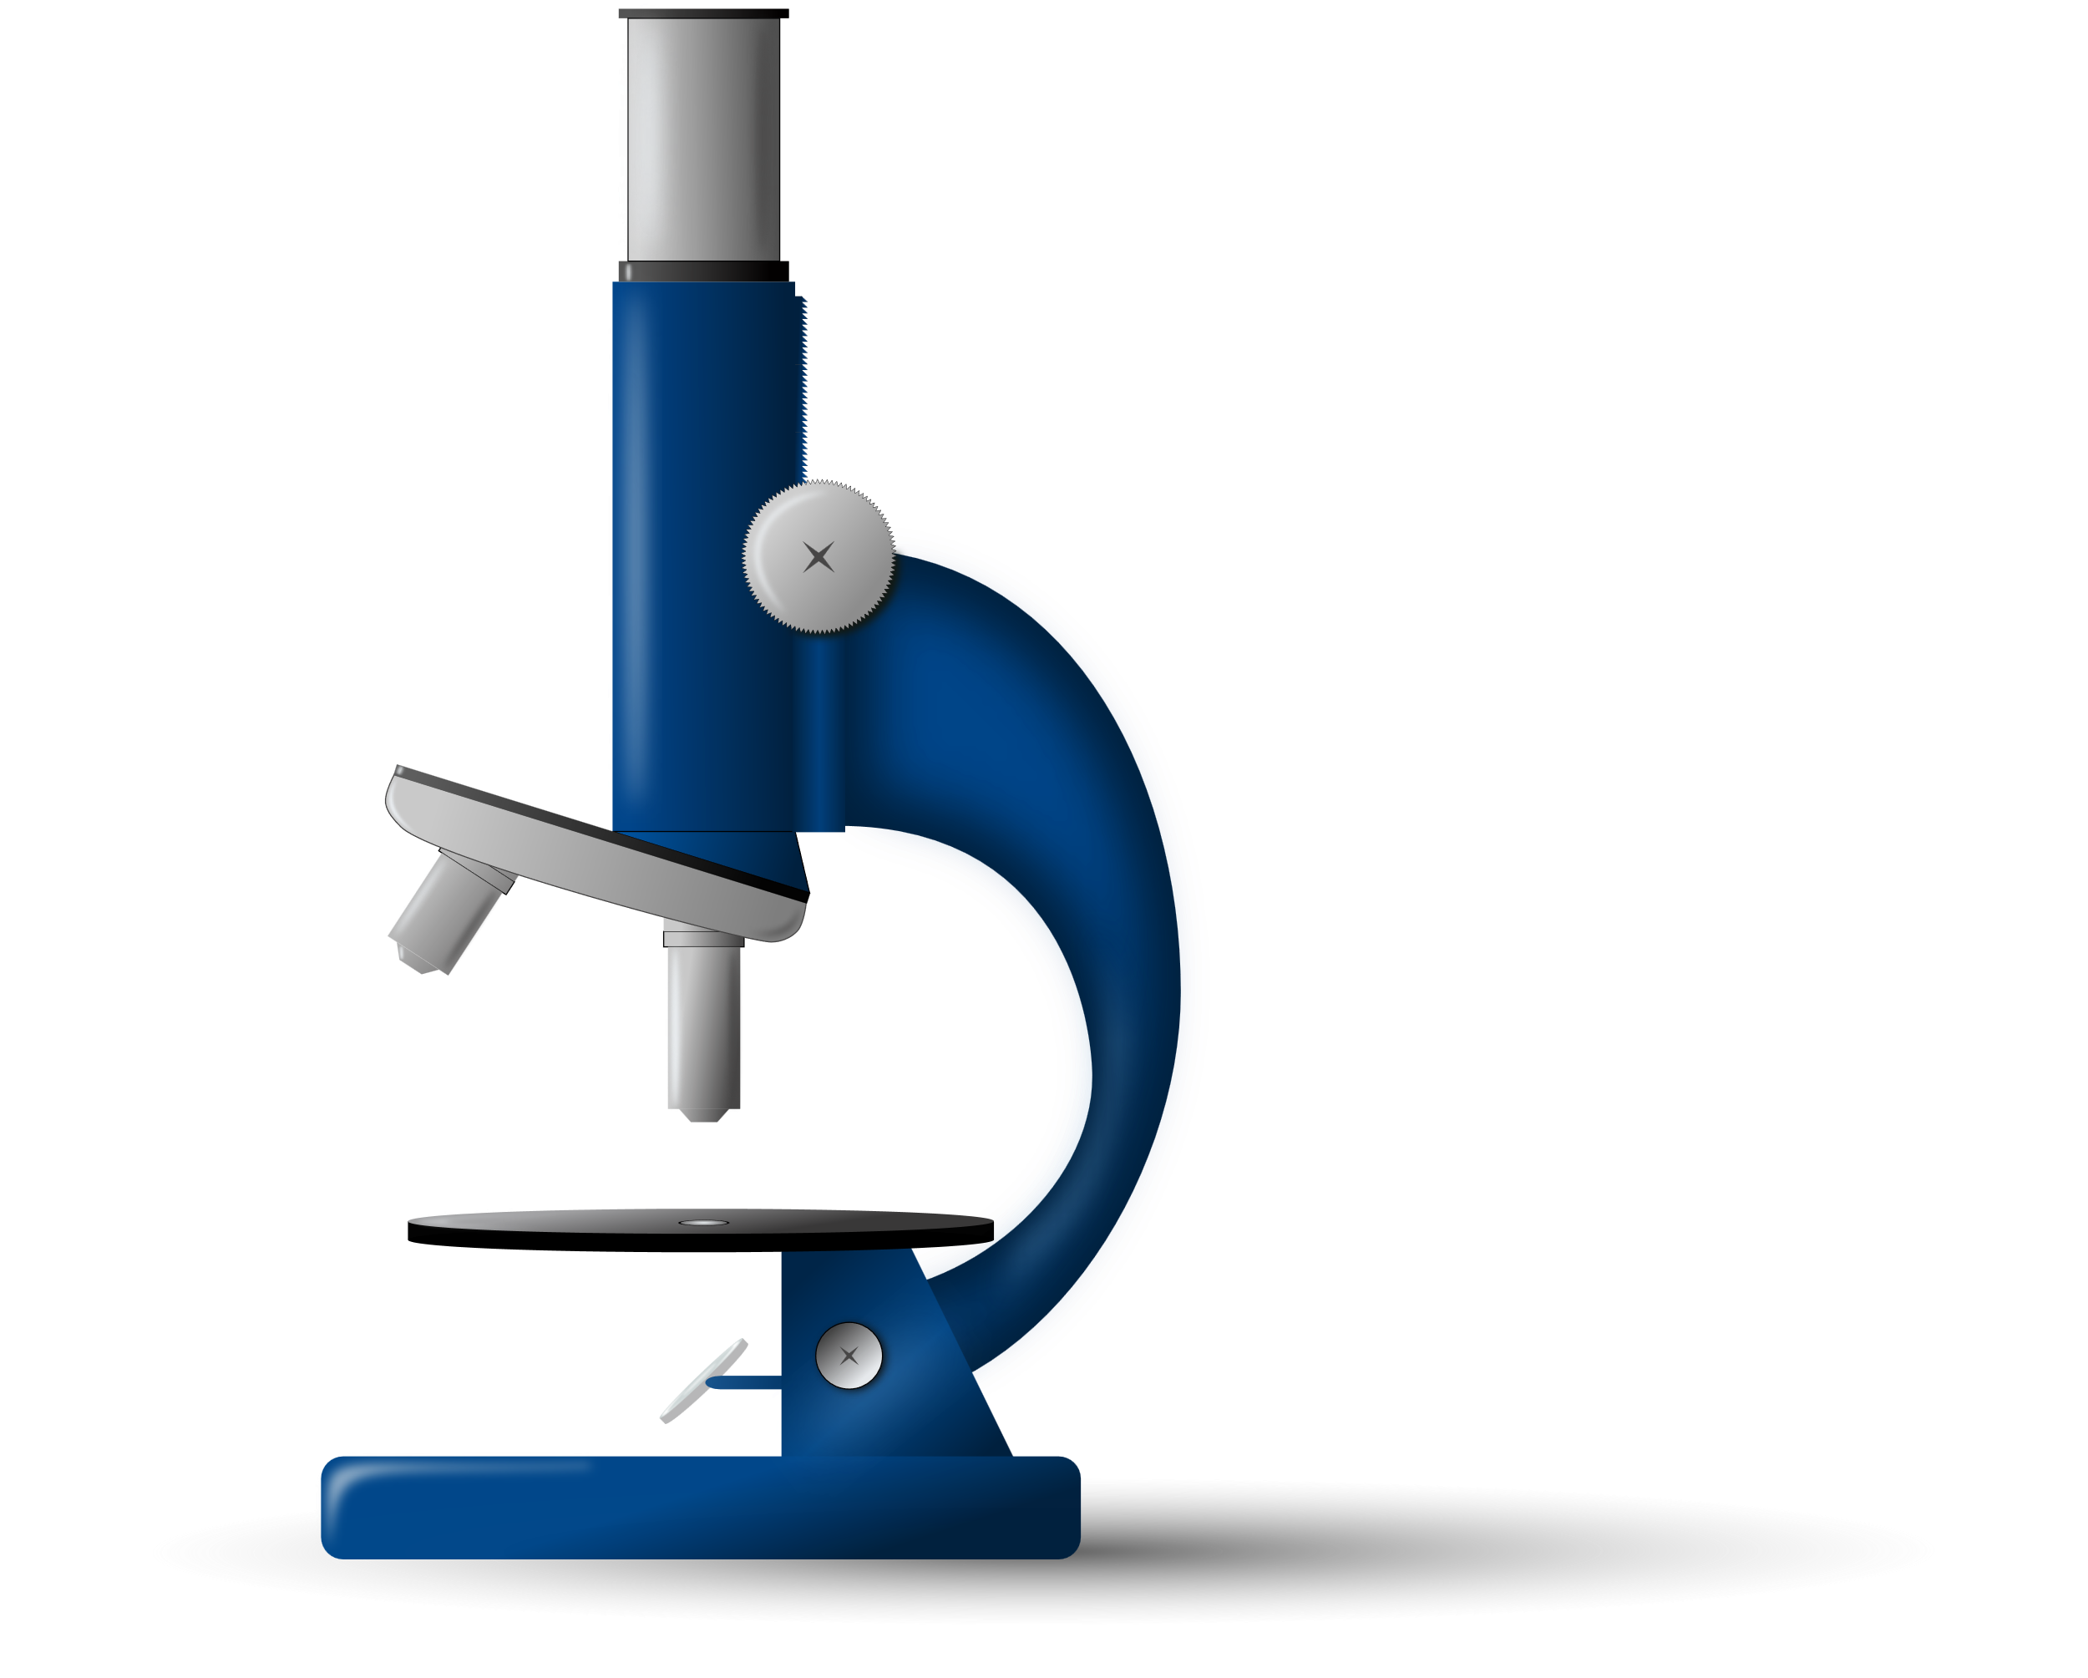
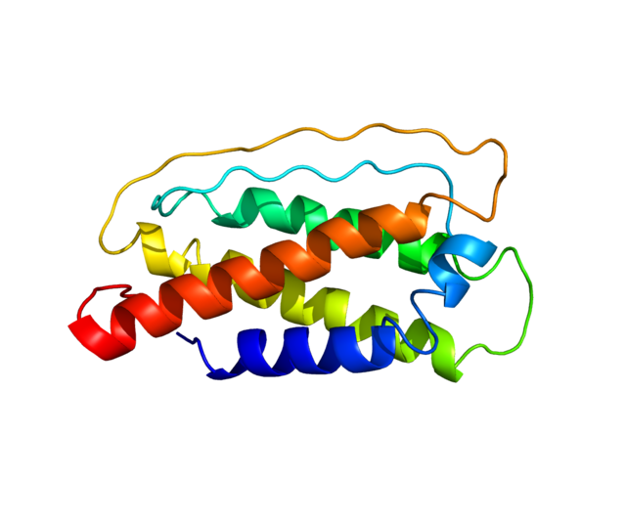
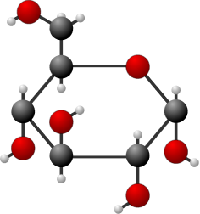
Genomics
DNA
Transcriptomics
mRNA
Proteomics
Proteins
Metabolomics
Fluxes
Metabolites
$$\frac{dx}{dv}=…$$
Fluxomics
Phenotype and function

Slide 7
FBA
MFA
¹³C-MFA
¹³C-INST MFA
Flux balance
analysis
Metabolic flux
analysis
Isotopically Nonstationary
Metabolic flux analysis
Glucose
Uptake/ Release
Fluxes
ATP
Conc. (mM)
Isotopic labelling
Glutamine
Time
$v_{r}$ 1 2 3
M+ 0 1 2 3
M+ 0 1 2 3
Time
$$\max{V_{growth}}$$
$$s.t. S∗\overline{v}=0 \\ lb<\overline{v}<ub$$
$$\min{∑(v_{r}−{\hat{v}}_{r}) }$$
$$s.t. S∗\overline{v}=0 \\ \overline{v}≥0$$
$$\min{∑(x_{i}(\overline{v})−\hat{x_{i}}) }$$
$$s.t. S∗\overline{v}=0 \\ v̅≥0$$
$$\min{∑∑(x_{i,t}\left(\overline{v}\right)−{\hat{x}}_{i,t}) }$$
$$s.t. S∗\overline{v}=0 \\ \overline{v}≥0$$
Stoichiometric constraint
Large scale models
(genome-scale)
Small scale models
(Core metabolism)
Medium scale models
(Metabolomics)

Slide 8
Why isotopic labelling?
Parallel pathways
Internal
cycles
Reversible
reactions
Unbalances
Co-metabolites
Wiechert W., 2001, Metab. Eng.

Slide 9
Glucose
¹³C
Glycolysis
¹³C-INST MFA
¹³C-MFA
Pyruvate
Glucose Pyruvate
¹³C – Labelling
Isotopic steady state
TCA -cycle
Time

Slide 10
Reactions
$$v_{1}$$
$$v_{2}$$
$$v_{6}$$
A
B
D
F
$$v_{1} \\ v_{2} \\ v_{3} \\ v_{4} \\ v_{5} \\ v_{6}$$
$$A→B \\ B→D \\ D→B \\ B→C+E \\ B+C→D+2E \\ D→F$$
$$v_{3}$$
$$v_{4}$$
E
$$v_{5}$$
C
E
2x

Slide 11
Reactions
$$v_{1}$$
$$v_{2}$$
$$v_{6}$$
A
B
D
F
$$v_{1} \\ v_{2} \\ v_{3} \\ v_{4} \\ v_{5} \\ v_{6}$$
$$A→B \\ B→D \\ D→B \\ B→C+E \\ B+C→D+2E \\ D→F$$
$$v_{3}$$
$$v_{4}$$
E
$$v_{5}$$
C
E
2x

Slide 12
Reactions
$$v_{1}$$
$$v_{2}$$
$$v_{6}$$
A
B
D
F
$$v_{1} \\ v_{2} \\ v_{3} \\ v_{4} \\ v_{5} \\ v_{6}$$
$$A→B \\ B→D \\ D→B \\ B→C+E \\ B+C→D+2E \\ D→F$$
$$v_{3}$$
$$v_{4}$$
E
$$v_{5}$$
C
E
2x

Slide 13
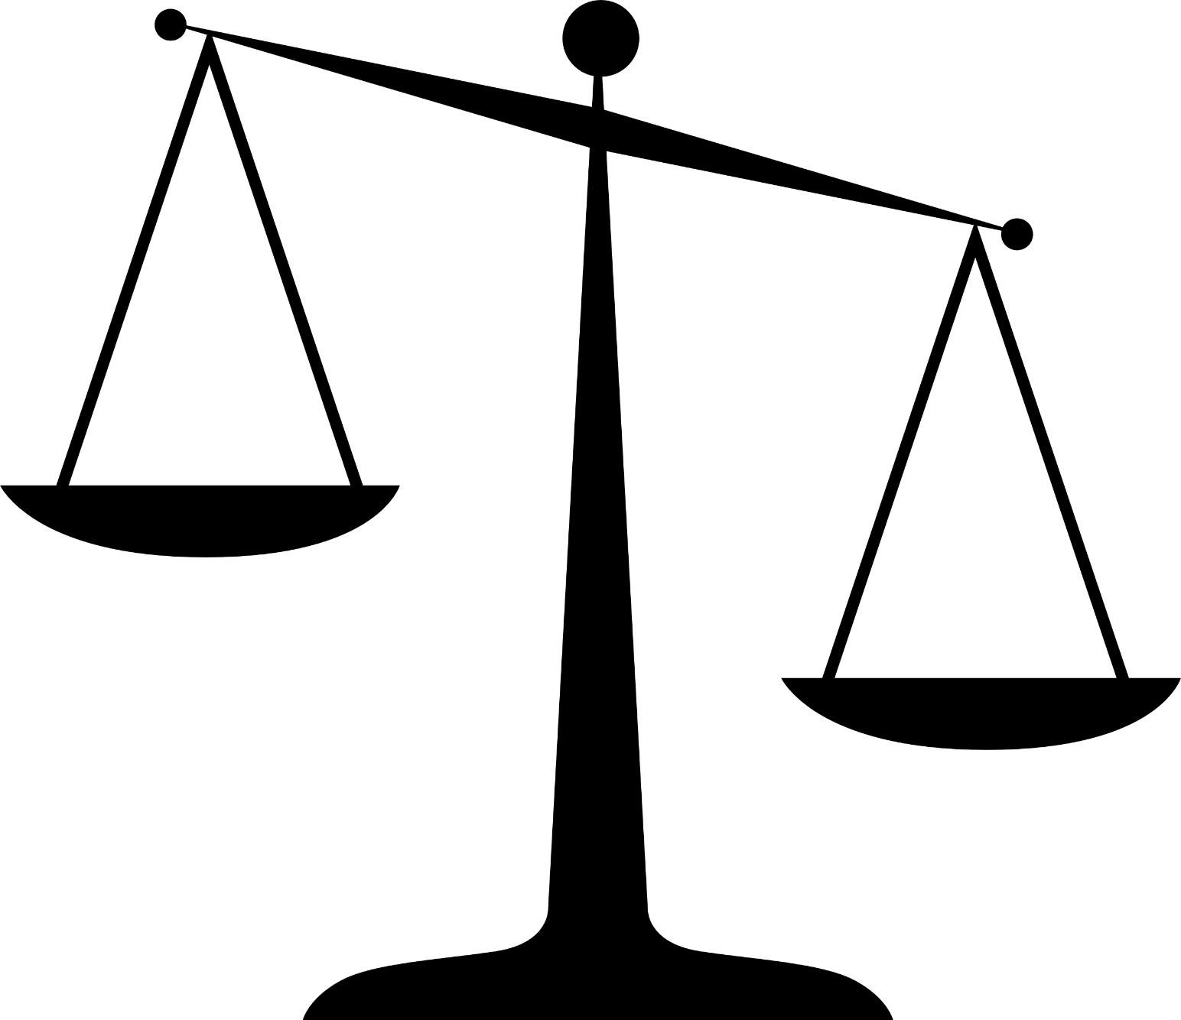
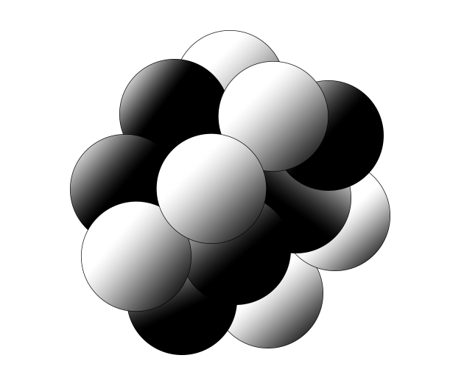
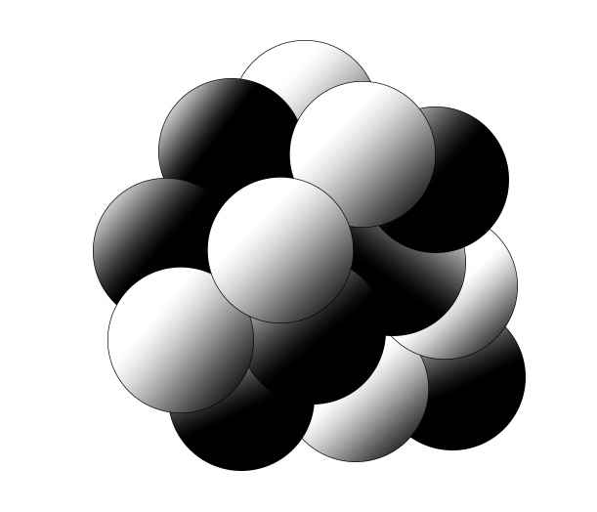
Reactions
Mass Isotopomer Distribution (MID)
$$v_{1}$$
$$v_{2}$$
$$v_{6}$$
A
B
D
F
$$v_{1} \\ v_{2} \\ v_{3} \\ v_{4} \\ v_{5} \\ v_{6}$$
¹³C
¹²C
$$A→B \\ B→D \\ D→B \\ B→C+E \\ B+C→D+2E \\ D→F$$
$$v_{3}$$
13%
12%
F
Isotope isomers
=
$$v_{4}$$
E
$$v_{5}$$
$$0.50$$
Isotopomers
C
$$0.25$$
E
25%
2x
$$0.12$$
$$0.13$$
50%
$$F_{MID}=[0.12 0.25 0.5 0.13]$$

Slide 14
Isotope isomers
=
Mass Isotopomer Distribution (MID)
Isotopomers
¹³C
¹²C
13%
12%
$$0.50$$
F
$$0.25$$
$$0.12$$
$$0.13$$
25%
50%
$$F_{MID}=[0.12 0.25 0.5 0.13]$$

Slide 15
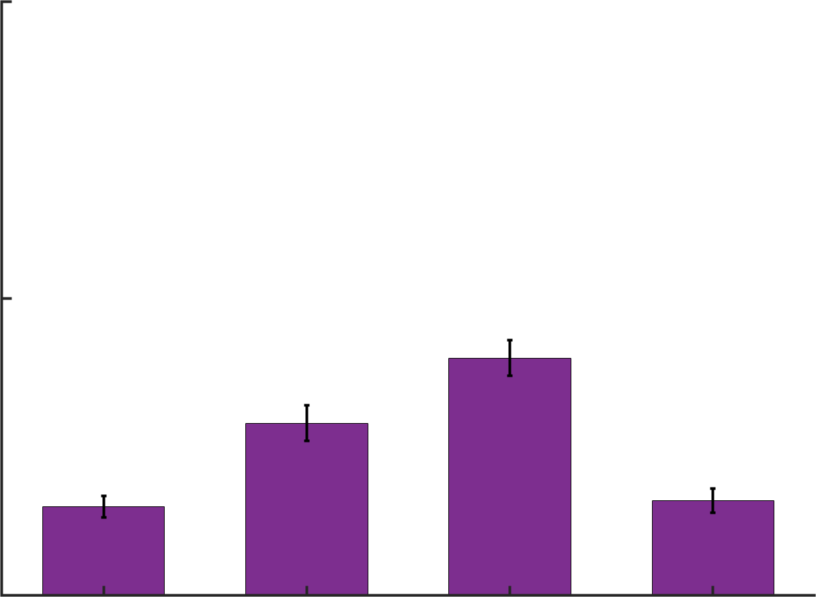
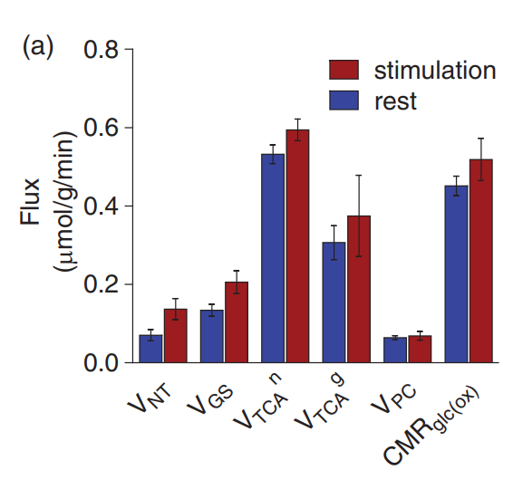
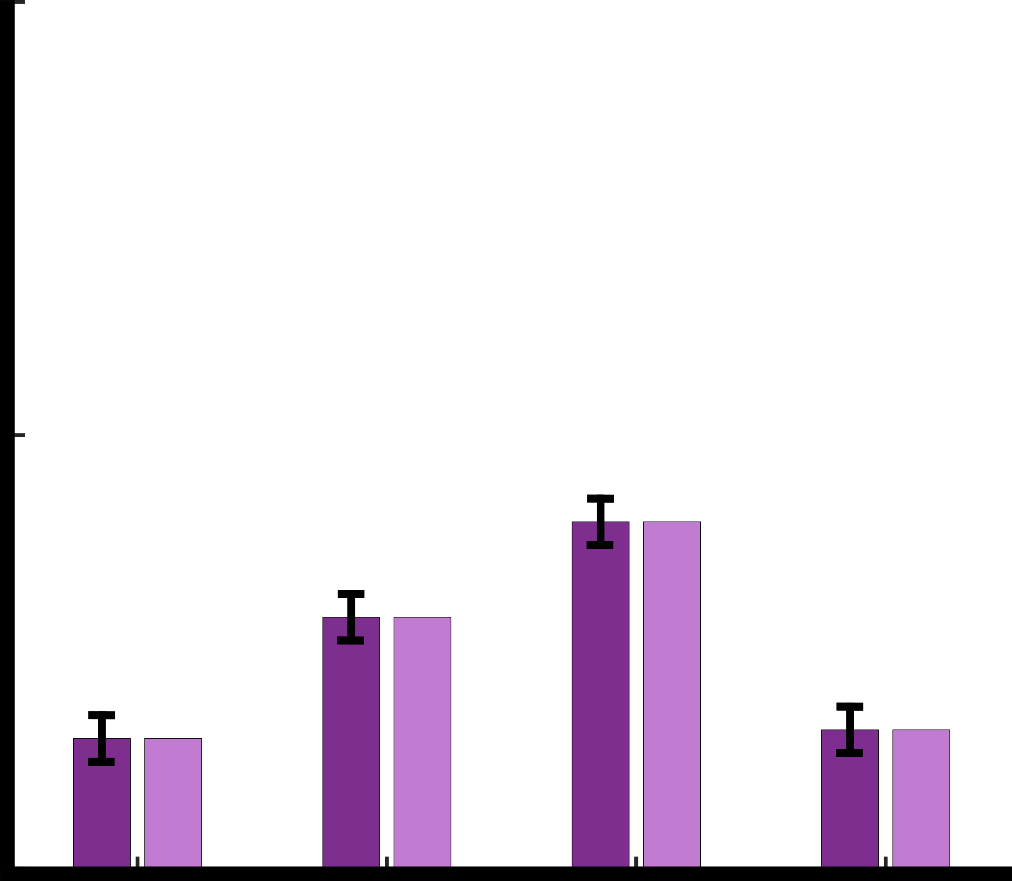
M+3
M+0
Mass Isotopomer Distribution (MID)
Experimental Data
1
¹³C
0.5
¹²C
M+1
M+2
A
B
D
F
0
M+0
M+1
M+2
M+3
Substrate
Tracer
$$\frac{dx}{dv}=…$$
Model
C
E
$$A_{n,k}\left(v\right)X_{n,k}=B_{n,k}\left(v\right)Y_{n,k}\left(y_{n}^{in},X_{n−1},…,X_{1}\right)$$
Cell system
1
A
B
D
F
$$σ_{i}$$
$$\hat{x_{i}}(v)$$
0.5
$$x_{i}$$
C
E
0
M+0
M+1
M+2
M+3

Slide 16
Stoichiometry
$$v_{1}$$
$$v_{2}$$
$$v_{6}$$
$$⇒ \left\{\begin{aligned} v_{1}+v_{3}=v_{2}+v_{4}+v_{5} \\ v_{4}=v_{5} \\ v_{5}+v_{2}=v_{3}+v6\end{aligned}\right.$$
A
B
D
F
$$v_{3}$$
E
$$v_{4}$$
$$v_{5}$$
C
E
2x
 | $$v_{1}$$ | $$v_{2}$$ | $$v_{3}$$ | $$v_{4}$$ | $$v_{5}$$ | $$v_{6}$$
A | -1 | 0 | 0 | 0 | 0 | 0
B | 1 | -1 | 1 | -1 | -1 | 0
C | 0 | 0 | 0 | 1 | -1 | 0
D | 0 | 1 | -1 | 0 | 1 | -1
E | 0 | 0 | 0 | 1 | 2 | 0
F | 0 | 0 | 0 | 0 | 0 | 1
 | $$v_{1}$$ | $$v_{2}$$ | $$v_{3}$$ | $$v_{4}$$ | $$v_{5}$$ | $$v_{6}$$
A | -1 | 0 | 0 | 0 | 0 | 0
B | 1 | -1 | 1 | -1 | -1 | 0
C | 0 | 0 | 0 | 1 | -1 | 0
D | 0 | 1 | -1 | 0 | 1 | -1
E | 0 | 0 | 0 | 1 | 2 | 0
F | 0 | 0 | 0 | 0 | 0 | 1
$$\overline{v}=\left[\begin{matrix}v_{1} \\ v_{2} \\ v_{3} \\ v_{4} \\ v_{5} \\ v_{6}\end{matrix}\right]$$
$$S=\left[\begin{matrix}1 & −1 & 1 & −1 & −1 & 0 \\ 0 & 0 & 0 & 1 & −1 & 0 \\ 0 & 1 & −1 & 0 & 1 & −1\end{matrix}\right]$$
$$\overline{u}=\left[\begin{matrix}v_{1} \\ v_{3} \\ v_{4}\end{matrix}\right]$$
Independent fluxes
Steady state condition
$$\begin{matrix}v_{1}−v_{2}+v_{3}−v_{4}−v_{5}=0 \\ v_{4}−v_{5}=0 \\ v_{2}−v_{3}+v_{5}−v_{6}=0\end{matrix}$$
$$v_{2}=v_{1}+v_{3}−{2∗v}_{4}$$
$$S∗\overline{v}=0$$
$$v_{5}=v_{4}$$
$$\overline{v}=N∗\overline{u}$$
$$v_{6}=v_{1}−v_{4}$$
$$N= null(S)$$

Slide 17
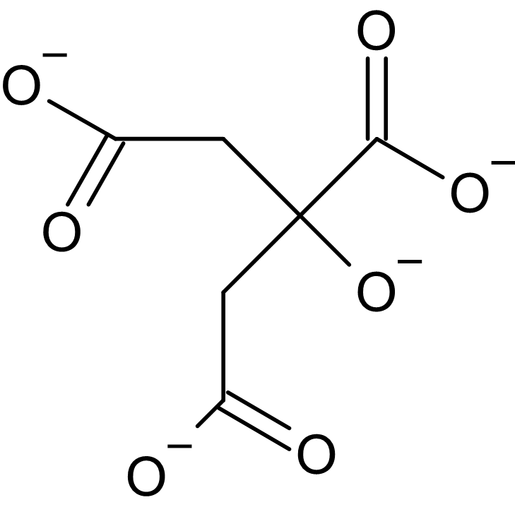
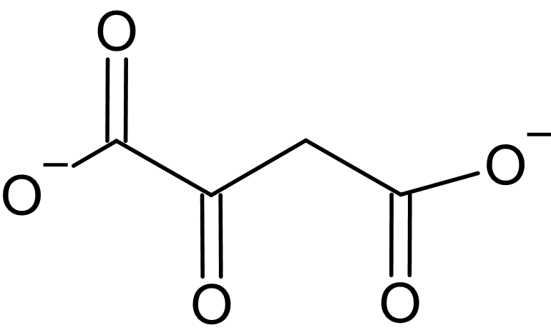
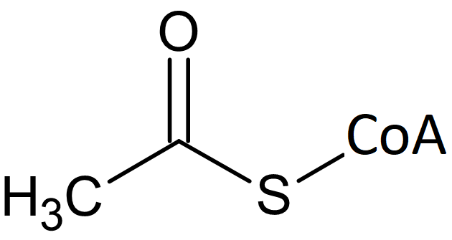
Atom mapping
2
1
4
2
4
2
3
1
3
1
$$+$$
2
1
H₂O
HS-CoA
Oxaloacetate
Acetyl-CoA
Citrate

Slide 18
Atom mapping
$$v_{1} A\left(123\right)→B\left(123\right)$$
$$v_{2} B\left(123\right)→D\left(123\right)$$
$$v_{1}$$
$$v_{2}$$
$$v_{6}$$
$$v_{3} D\left(123\right)→B\left(123\right)$$
A
B
D
F
$$v_{3}$$
$$v_{4} B\left(123\right)→C\left(23\right)+E\left(1\right)$$
E
$$v_{4}$$
$$v_{5}$$
$$v_{5} B\left(123\right)+C\left(45\right)→D\left(234\right)+E\left(1\right)+E\left(5\right)$$
C
E
$$v_{6} D\left(123\right)→F(123)$$
2x
A
B
D
F
$$v_{1}$$
$$v_{2}$$
$$v_{6}$$
1
1
1
1
2
1
3
$$v_{3}$$
E
$$v_{5}$$
$$v_{4}$$
1
C
E
2 3

Slide 19
ODE equations
abc
$$v_{1}$$
$$v_{2}$$
$$v_{6}$$
A
B
D
F
abc
$$v_{3}$$
E
$$v_{4}$$
$$v_{5}$$
C
E
2x
$$\frac{d}{dt}A_{a}=−v_{1}A_{a}$$
$$\frac{d}{dt}B_{a}=v_{1}A_{a}−v_{2}B_{a}+v_{3}D_{a}−v_{4}B_{a}$$
$$\frac{d}{dt}C_{a}=v_{4}B_{b}−v_{5}C_{a}$$
$$\frac{dMij}{dt}=\sum_{k∈In(i)}{vk}\sum_{θ∈Gen(k,i,j)}{\prod_{\left(l,m\right)∈θ}{rlm}}−\left(\sum_{k∈Out(i)}{vk}\right)rij=0$$
$$\frac{d}{dt}A_{b}=−v_{1}A_{b}$$
$$\frac{d}{dt}B_{b}=v_{1}A_{b}−v_{2}B_{b}+v_{3}D_{b}−v_{4}B_{b}$$
$$\frac{d}{dt}C_{b}=v_{4}B_{c}−v_{5}C_{b}$$
$$\frac{d}{dt}A_{c}=−v_{1}A_{c}$$
$$\frac{d}{dt}B_{c}=v_{1}A_{c}−v_{2}B_{c}+v_{3}D_{c}−v_{4}B_{c}$$
$$…$$
$$\frac{d}{dt}A_{a0}=−v_{1}A_{a0}$$
Number of C-atoms: $N$
Number of states: $N^{2}$
Example: 225 states
$$\frac{d}{dt}A_{a1}=−v_{1}A_{a1}$$
$$\frac{d}{dt}A_{ab10}=−v_{1}A_{a10}$$
$$…$$
Notes:
M_{ij} is the abundance of the jth isotopomer of Metabolite M_{i} the V are the fluxes that produce respectively consume M_{ij}
r is the fraction of isotopomers.
We also have the steady state constrain form earlier with the stoichiometric matrix and the flux vector, equals to zero.
And this is all good except for one thing and that is the sheer number of isotopomers

Slide 20
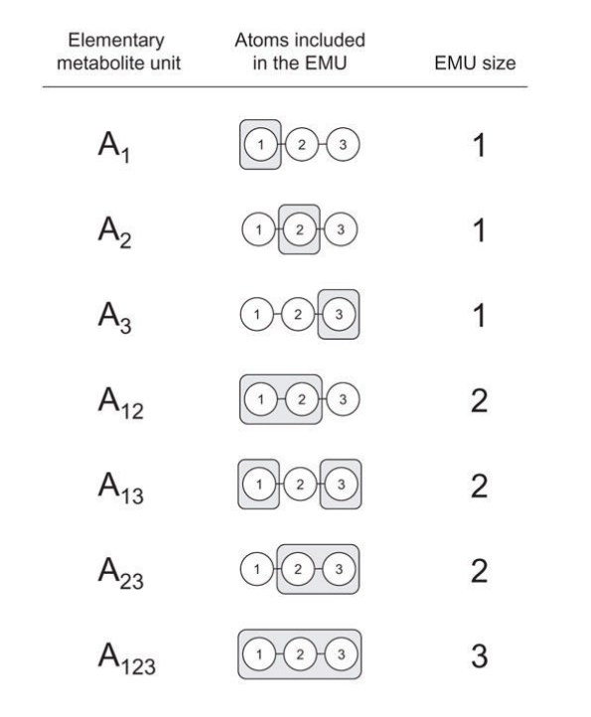
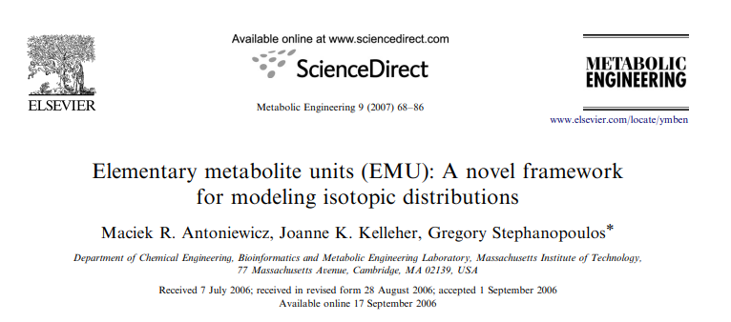
EMUs
U
E
M
Elementary Metabolite Units
A
1
2
3

Slide 21
A
EMUs
1
2
3
1
2
A
M+ 0 M+ 1 M+2
1
2
3
M+ 0 M+ 1
1
2
3
1
2
3
1
2
3
1
2
3
M+ 0 M+ 1 M+2
2
1
3
M+ 0 M+ 1
M+ 0 M+ 1 M+2
3
1
2
3
M+ 0 M+ 1
M+ 0 M+ 1 M+2 M+3

Slide 22
A
EMUs
1
2
3
1
2
M+ 0 M+ 1 M+2
1
2
3
M+ 0 M+ 1
M+ 0 M+ 1 M+2
2
1
3
M+ 0 M+ 1
M+ 0 M+ 1 M+2
3
1
2
3
M+ 0 M+ 1
M+ 0 M+ 1 M+2 M+3

Slide 23
A
EMUs
1
2
3
$$0.50$$
$$0.25$$
$$0.12$$
$$0.13$$
$$0.12$$
$$A_{123}=\left[\begin{matrix}A_{123,M+0} \\ A_{123,M+1} \\ A_{123,M+2} \\ A_{123,M+3}\end{matrix}\right]=\left[\begin{matrix}0.12 \\ 0.25 \\ 0.50 \\ 0.13\end{matrix}\right]$$
$$0.05$$
$$0.07$$
$$0.13$$
$$0.17$$
$$0.23$$
$$0.10$$
$$\sum{=1}$$
$$0.13$$
A
$$\sum{=1}$$
$$0.05$$
$$0.12$$
$$0.17$$
$$≡\{ \}$$
]
]
$$A_{23}=\left[\begin{matrix}A_{23,M+0} \\ A_{23,M+1} \\ A_{23,M+2}\end{matrix}\right]=\left[\begin{matrix}0.17 \\ 0.60 \\ 0.23\end{matrix}\right]$$
$$0.17$$
$$0.07$$
$$0.24$$
$$≡\{ \}$$
]
]
$$0.23$$
$$0.13$$
$$0.36$$
$$≡\{ \}$$
]
]
EMU
$$\sum{=1}$$
$$0.13$$
$$0.10$$
$$0.23$$
$$≡\{ \}$$
]
]
Mass Isotopomers Mass fractions
$$\sum{=1}$$
$$\sum{=1}$$
Isotopomers

Slide 24
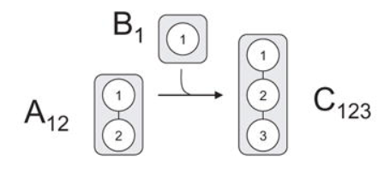
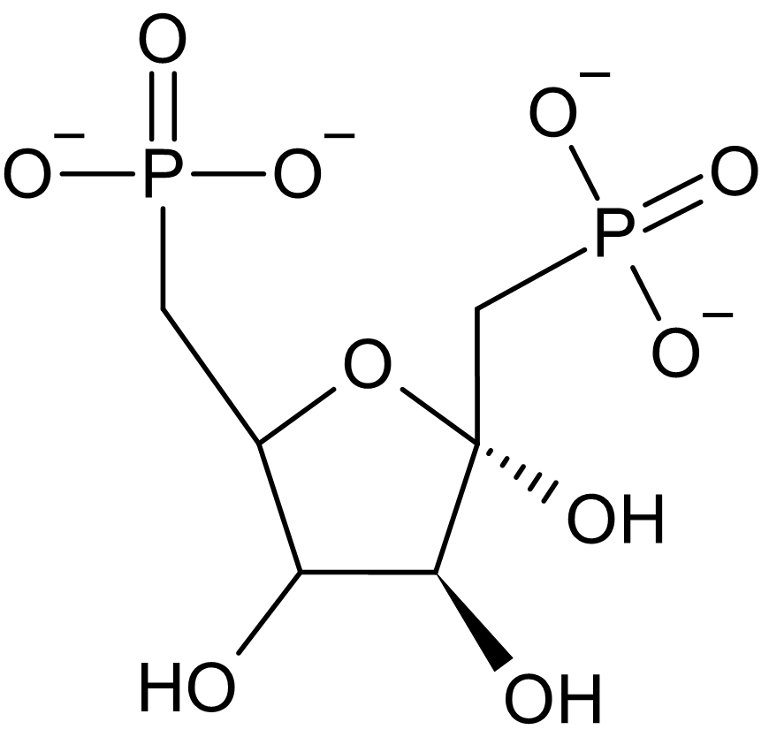
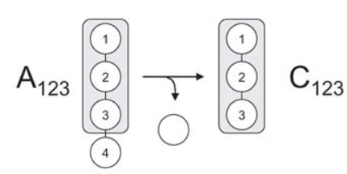
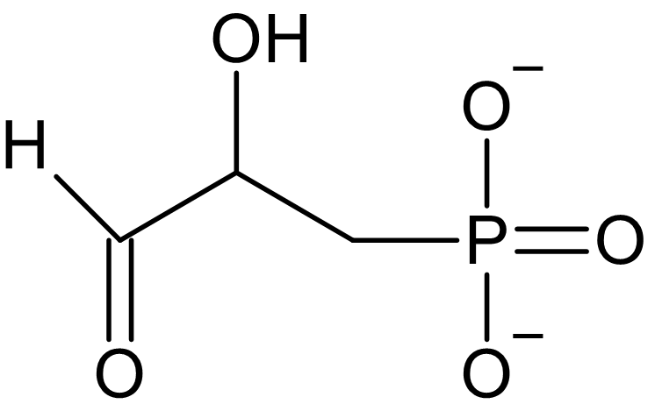
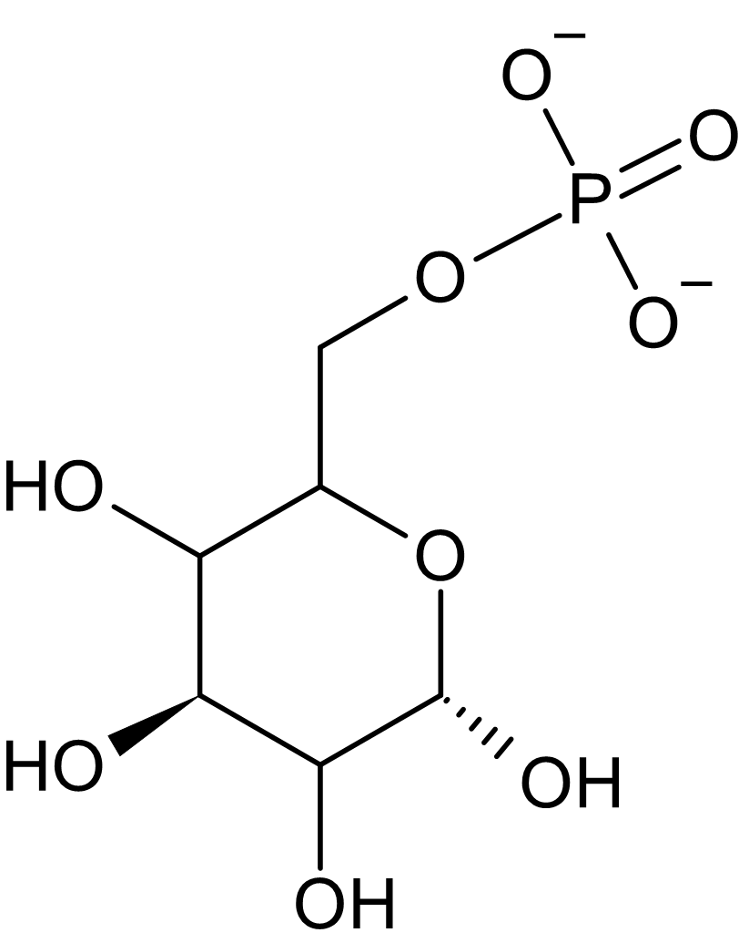
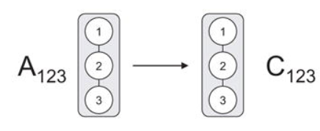
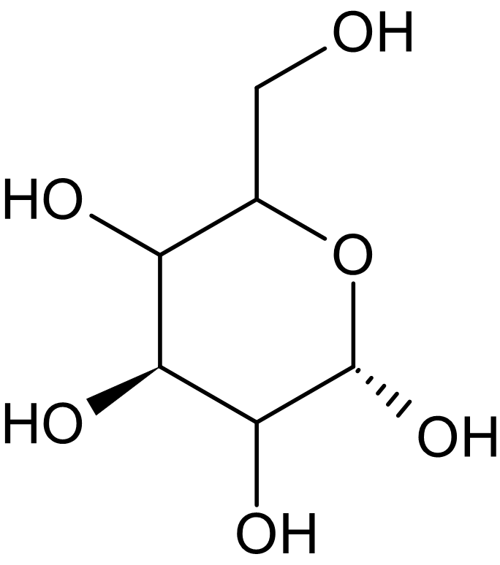
EMUs
Antoniewicz et al.,Metab. Eng., 2006
A) Condensation reaction
Oxaloacetate
Acetyl-CoA
$$C_{123}=A_{12}×B_{1}$$
$$\left[\begin{matrix}C_{123,M+0} \\ C_{123,M+1} \\ C_{123,M+2} \\ C_{123,M+3}\end{matrix}\right]=\left[\begin{matrix}A_{12,M+0}∗B_{1,M+0} \\ A_{12,M+0}∗B_{1,M+1}+A_{12,M+1}∗B_{1,M+0} \\ A_{12,M+1}∗B_{1,M+1}+A_{12,M+2}∗B_{1,M+0} \\ A_{12,M+2}∗B_{1,M+1}\end{matrix}\right]$$
1
2
3
4
$$+$$
1
2
H₂O
2
1
3
4
HS-CoA
2
B) Cleavage reaction
1
$$C_{123}=A_{123}$$
$$\left[\begin{matrix}C_{123,M+0} \\ C_{123,M+1} \\ C_{123,M+2} \\ C_{123,M+3}\end{matrix}\right]=\left[\begin{matrix}A_{123,M+0} \\ A_{123,M+1} \\ A_{123,M+2} \\ A_{123,M+3}\end{matrix}\right]$$
Citrate
1
6
2
5
3
1
2
3
4
Dihydroxyacetone phosphate (4,5,6)
Fructose
1,6-biphosphate
Glyceraldehyde
3-phosphate
C) Unimolecular reaction
$$C_{123}=A_{123}$$
$$\left[\begin{matrix}C_{123,M+0} \\ C_{123,M+1} \\ C_{123,M+2} \\ C_{123,M+3}\end{matrix}\right]=\left[\begin{matrix}A_{123,M+0} \\ A_{123,M+1} \\ A_{123,M+2} \\ A_{123,M+3}\end{matrix}\right]$$
6
6
1
5
ADP
ATP
5
1
2
3
4
2
4
3
Glucose
6-phosphate
Glucose

Slide 25
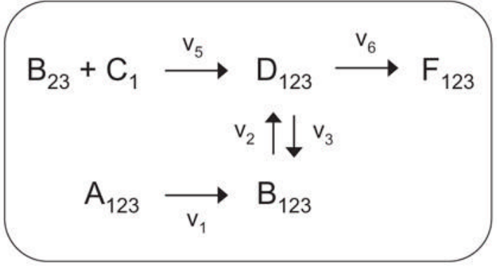
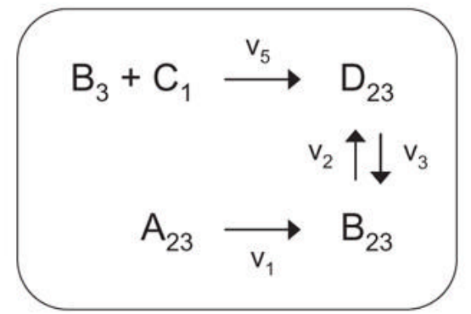
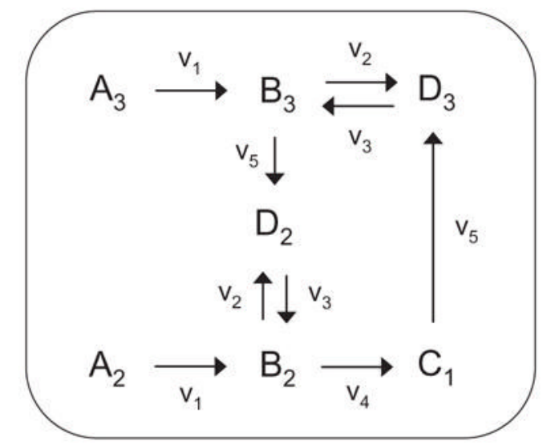
EMU Decomposition
$$v_{1}$$
$$v_{2}$$
$$v_{6}$$
$$D_{123}→F_{123} \\ B_{123}→D_{123} \\ B_{23}+C_{1}→D_{123} \\ A_{123}→B_{123} \\ D_{123}→B_{123}$$
A
$$v_{2}$$
F
B
$$v_{1}$$
D
$$v_{6}$$
EMU
size 3
A
B
D
F
$$v_{3}$$
$$v_{3}$$
E
$$v_{4}$$
$$v_{5}$$
$$v_{4}$$
C
E
$$v_{5}$$
2x
E
$$A_{23}→B_{23} \\ D_{23}→B_{23} \\ B_{23}→D_{23} \\ B_{3}+C_{1}→D_{23}$$
EMU
size 2
C
E
2x
$$B_{2}→C_{1} \\ A_{2}→B_{2} \\ D_{2}→B_{2} \\ B_{2}→D_{2} \\ B_{3}→D_{2}$$
$$A_{3}→B_{3} \\ D_{3}→B_{3} \\ B_{3}−D_{3} \\ C_{1}→D_{3}$$
EMU
size 1

Slide 26
EMU Decomposition
$$D_{123}→F_{123} \\ B_{123}→D_{123} \\ B_{23}+C_{1}→D_{123} \\ A_{123}→B_{123} \\ D_{123}→B_{123}$$
$$v_{1}$$
$$v_{2}$$
$$v_{6}$$
EMU
size 3
A
B
D
F
$$v_{3}$$
E
$$v_{4}$$
$$v_{5}$$
C
E
2x
$$A_{23}→B_{23} \\ D_{23}→B_{23} \\ B_{23}→D_{23} \\ B_{3}+C_{1}→D_{23}$$
EMU
size 2
$$B_{2}→C_{1} \\ A_{2}→B_{2} \\ D_{2}→B_{2} \\ B_{2}→D_{2} \\ B_{3}→D_{2}$$
$$A_{3}→B_{3} \\ D_{3}→B_{3} \\ B_{3}−D_{3} \\ C_{1}→D_{3}$$
EMU
size 1

Slide 27
$$\frac{d}{dt}D23=v5∙\left(B3×C1\right)−v3∙D_{23}+v2∙B23=0$$
$$\frac{d}{dt}B23=v1∙A23 +v3∙D23−v2∙B_{23}=0$$
$$− v3∙D_{23}+v2∙B23=−v5∙\left(B3×C1\right)$$
$$+ v3∙D23−v2∙B_{23}=−v1∙A23$$
$$v_{2}=v_{1}+v_{3} +2v_{4}$$
$$\left[\begin{matrix}−v3 & v_{1}+v_{3}−2v_{4} \\ v3 & −v1−v_3+2v_{4}\end{matrix}\right]\left[\begin{matrix}D23 \\ B23\end{matrix}\right]=\left[\begin{matrix}−v5 & 0 \\ 0 & −v1\end{matrix}\right]\left[\begin{matrix}(B3×C1) \\ A23\end{matrix}\right]$$
$$v_{2}$$
$${−v}_{2}$$
Unknown Components
Known Components

Slide 28
$$\left(B_{3}×C_{1}\right)=\left[\begin{matrix}B_{3,M+0} & B_{3,M+1}\end{matrix}\right]×\left[\begin{matrix}C_{1,M+0} & C_{1,M+1}\end{matrix}\right]$$ $=\left[\begin{matrix}B_{3,M+0}∙C_{1,M+0} & (B_{3,M+0}∙C_{1,M+1}+B_{3,M+1}∙C_{1,M+0}) & B_{3,M+1}∙C_{1,M+1}\end{matrix}\right]$
New M+0 term
New M+1 term
New M+2 term
Discrete Convolution (Cauchy product )
$$\left[\begin{matrix}D_{23} \\ B_{23}\end{matrix}\right]=\left[\begin{matrix}D_{23,M+0} & D_{23,M+1} & D_{23,M+2} \\ B_{23,M+0} & B_{23,M+1} & B_{23,M+2}\end{matrix}\right]$$
$$\left[\begin{matrix}−v3 & v_{1}+v_{3} \\ v3 & −v1−v3\end{matrix}\right]\left[\begin{matrix}D23 \\ B23\end{matrix}\right]=\left[\begin{matrix}−v5 & 0 \\ 0 & −v1\end{matrix}\right]\left[\begin{matrix}(B3×C1) \\ A23\end{matrix}\right]$$
Notes:
The Cauchy product may apply to infinite series or power series. When people apply it to finite sequences or finite series, it is by abuse of language: they actually refer to discrete convolution. – Wikipedia

Slide 29
$$\frac{d}{dt}F_{123}={0 ∙\left(B_{23}×C_{1}\right)+0 ∙B_{123} +v}_{6} ∙D_{123}=0$$
$$\frac{d}{dt}D_{123}=v_{5}∙\left(B_{23}×C_{1}\right)+v_{2}∙B_{123}−\left(v_{3}+v_{6}\right)∙D_{123}=0$$
$$\frac{d}{dt}B_{123}=v_{1}∙A_{123} −v_{2}∙B_{123}+v_{3} ∙D_{123}=0$$
$${0 ∙B_{123} +v}_{6} ∙D_{123}=0 ∙\left(B_{23}×C_{1}\right)$$
$$v_{2}∙B_{123}−\left(v_{3}+v_{6}\right)∙D_{123}={−v}_{5}∙\left(B_{23}×C_{1}\right)$$
$$v_{2}∙B_{123}+v_{3} ∙D_{123}={−v}_{1}∙A_{123}$$
$$\left[\begin{matrix}0 & v_{6} & 0 \\ 0 & −v_{3}−v_{6} & v_{2} \\ 0 & v_{3} & v_{2}\end{matrix}\right]\left[\begin{matrix}F_{123} \\ D_{123} \\ B_{123}\end{matrix}\right]=\left[\begin{matrix}0 & 0 \\ −v_{5} & 0 \\ 0 & −v_{1}\end{matrix}\right]\left[\begin{matrix}(B_{23}×C_{1}) \\ A_{123}\end{matrix}\right]$$

Slide 30
$$\frac{d}{dt}C_{1}=v_{4}∙B_{2}−v_{5}∙C_{1}=0$$
$$\frac{d}{dt}B_{2}=v_{1}∙A_{2}+v_{3}∙D_{2}−\left(v_{2}+v_{4}\right)∙B_{2}=0$$
$$\frac{d}{dt}D_{2}=v_{5}∙B_{3}+v_{2}∙B_{2}−v_{3}∙D_{2}=0$$
$$\frac{d}{dt}B_{3}=v_{1}∙A_{3}+v_{3}∙D_{3}−\left(v_{2}+v_{5}\right)∙B_{3}=0$$
$$\frac{d}{dt}D_{3}=v_{2}∙B_{3}+v_{5}∙C_{1}−v_{2}∙D_{3}=0$$
$$\left[\begin{matrix}−v_{5} & v_{4} & 0 & 0 & 0 \\ 0 & −v_{2}−v_{4} & v_{3} & 0 & 0 \\ 0 & v_{2} & −v_{3} & v_{5} & 0 \\ 0 & 0 & 0 & −v_{2}−v_{5} & v_{3} \\ v_{5} & 0 & 0 & v_{2} & −v_{2}\end{matrix}\right]\left[\begin{matrix}C_{1} \\ B_{2} \\ D_{2} \\ B_{3} \\ D_{3}\end{matrix}\right]=\left[\begin{matrix}0 & 0 \\ −v_{1} & 0 \\ 0 & 0 \\ 0 & −v_{1} \\ 0 & 0\end{matrix}\right]\left[\begin{matrix}A_{2} \\ A_{3}\end{matrix}\right]$$
Notes:
Vid EMU dekompositionen nyttjar vi att vi vet att all inflöden till en EMU är lika med alla utflöden till EMUn. Därför behöver vi bara utrycka flödernai form av inflödenra.
Detta är användbart då EMU algorithmen bara hittar det som skapar (i.e. inflöderna till) en EMU.

Slide 31
$$\left[\begin{matrix}−v_{5} & v_{4} & 0 & 0 & 0 \\ 0 & −v_{2}−v_{4} & v_{3} & 0 & 0 \\ 0 & v_{2} & −v_{3} & v_{5} & 0 \\ 0 & 0 & 0 & −v_{2}−v_{5} & v_{3} \\ v_{5} & 0 & 0 & v_{2} & −v_{2}\end{matrix}\right]\left[\begin{matrix}C_{1} \\ B_{2} \\ D_{2} \\ B_{3} \\ D_{3}\end{matrix}\right]=\left[\begin{matrix}0 & 0 \\ −v_{1} & 0 \\ 0 & 0 \\ 0 & −v_{1} \\ 0 & 0\end{matrix}\right]\left[\begin{matrix}A_{2} \\ A_{3}\end{matrix}\right]$$
EMU
size 1
$$A_{1,1}(v)$$
$$X_{1,1}$$
$$=$$
$$B_{1,1}(v)$$
$$Y_{1,1}(y_{1}^{in})$$
EMU size 2
$$\left[\begin{matrix}−v5−v2 & v2 \\ v3 & −v1−v3\end{matrix}\right]\left[\begin{matrix}D23 \\ B23\end{matrix}\right]=\left[\begin{matrix}−v5 & 0 \\ 0 & −v1\end{matrix}\right]\left[\begin{matrix}(B3×C1) \\ A23\end{matrix}\right]$$
$$A_{2,1}(v)$$
$$X_{2,1}$$
$$=$$
$$B_{2,1}(v)$$
$$Y_{2,1}(y_{2}^{in},X_{1,1})$$
$$\left[\begin{matrix}0 & v_{6} & 0 \\ 0 & −v_{3}−v_{6} & v_{2} \\ 0 & v_{3} & v_{2}\end{matrix}\right]\left[\begin{matrix}F_{123} \\ D_{123} \\ B_{123}\end{matrix}\right]=\left[\begin{matrix}0 & 0 \\ −v_{5} & 0 \\ 0 & −v_{1}\end{matrix}\right]\left[\begin{matrix}(B_{23}×C_{1}) \\ A_{123}\end{matrix}\right]$$
EMU size 3
$$A_{3,1}(v)$$
$$X_{3,1}$$
$$=$$
$$B_{3,1}(v)$$
$${Y_{3,1}(y_{3}^{in},X}_{2,1},X_{1,1})$$
$$∀ i=1…n \\ k=1$$
$$A_{n,k}\left(v\right)X_{n,k}=B_{n,k}\left(v\right)Y_{n,k}\left(y_{n}^{in},X_{n−1},…,X_{1}\right)$$
$$→X_{i}=A_{i}^{−1}B_{i}Y_{i}$$

Slide 32
FBA
MFA
¹³C-MFA
¹³C-INST MFA
$v_{r}$ 1 2 3
Flux balance
analysis
Metabolic flux
analysis
Isotopically Nonstationary
Metabolic flux analysis
Glucose
Uptake/ Release
Fluxes
M+ 0 1 2 3
ATP
Conc. (mM)
Isotopic labelling
Glutamine
Time
$v_{r}$ 1 2 3
M+ 0 1 2 3
M+ 0 1 2 3
Time
$$\max{V_{growth}}$$
$$s.t. S∗\overline{v}=0 \\ lb<\overline{v}<ub$$
$$\min{∑(v_{r}−{\hat{v}}_{r}) }$$
$$s.t. S∗\overline{v}=0 \\ \overline{v}≥0$$
$$\min{∑(x_{i}(\overline{v})−\hat{x_{i}}) }$$
$$s.t. S∗\overline{v}=0 \\ v̅≥0$$
$$\min{∑∑(x_{i,t}\left(\overline{v}\right)−{\hat{x}}_{i,t}) }$$
$$s.t. S∗\overline{v}=0 \\ \overline{v}≥0$$
Large scale models
(genome-scale)
Small scale models
(Core metabolism)
Medium scale models
(Metabolomics)

Slide 33
Experimental Data
$$\frac{dx}{dv}=…$$
Model
$v_{r}$ 1 2 3
$$X_{n,k}=A_{n,k}^{−1}(\overline{v})B_{n,k}(\overline{v})Y_{n,k}$$
$$\hat{x}=\left[\begin{aligned}vec\left({\hat{X}}_{1,1}^{T}\right) \\ ⋮ \\ vec\left({\hat{X}}_{n,k}^{T}\right) \\ {\hat{v}}_{r}\end{aligned}\right]$$
$$x=\left[\begin{aligned}vec\left(X_{1,1}^{T}\right) \\ ⋮ \\ vec\left(X_{1,1}^{T}\right) \\ v_{r}\end{aligned}\right]$$
$$\overline{v}=N∗\overline{u}$$
M+ 0 1 2 3
$$if X=\left[\begin{matrix}a & b \\ c & d\end{matrix}\right] then vec\left(X\right)=\left[\begin{matrix}a \\ c \\ b \\ d\end{matrix}\right]$$
$$\min{∑(x_{i}(\overline{v})−\hat{x_{i}}) }$$
$$s.t. S∗\overline{v}=0 \\ v̅≥0$$
$$\underset{\overline{u}}{arg min}{∑(x_{i}(\overline{u})−\hat{x_{i}})}$$
$$s.t. \overline{v}≥0$$
$$c\left(x,\overline{v}\right)=0$$
$$A_{n,k}\left(v\right)X_{n,k}−B_{n,k}\left(v\right)Y_{n,k}\left(y_{n}^{in},X_{n−1},…,X_{1}\right)=0$$
Isotopic steady state
$$S∗\overline{v}=0$$
Metabolic steady state
$$\overline{v}−flux vector \\ \overline{u}−Independent flux vector$$
$$S−Stoichiometric matrix$$
$$N−Null space matrix$$

Slide 34
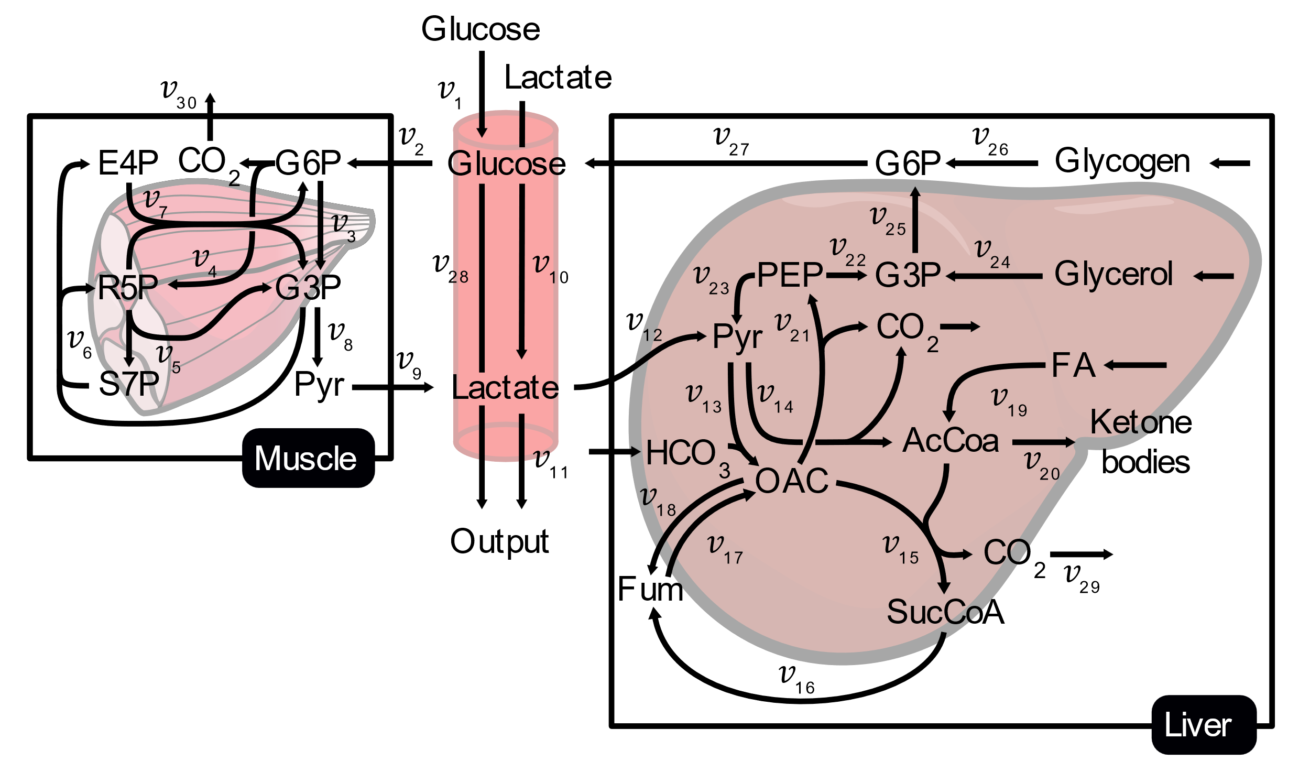
Glucose metabolism Model
Uptake/release Data
$v_{r}$ 1 2 3
MID Data
M+ 0 1 2 3
30 Fluxes
3 Compartments
26 Metabolites

Slide 35
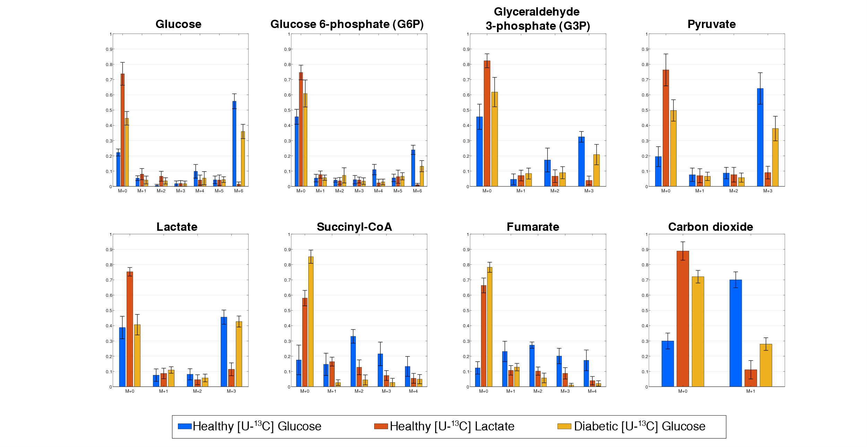
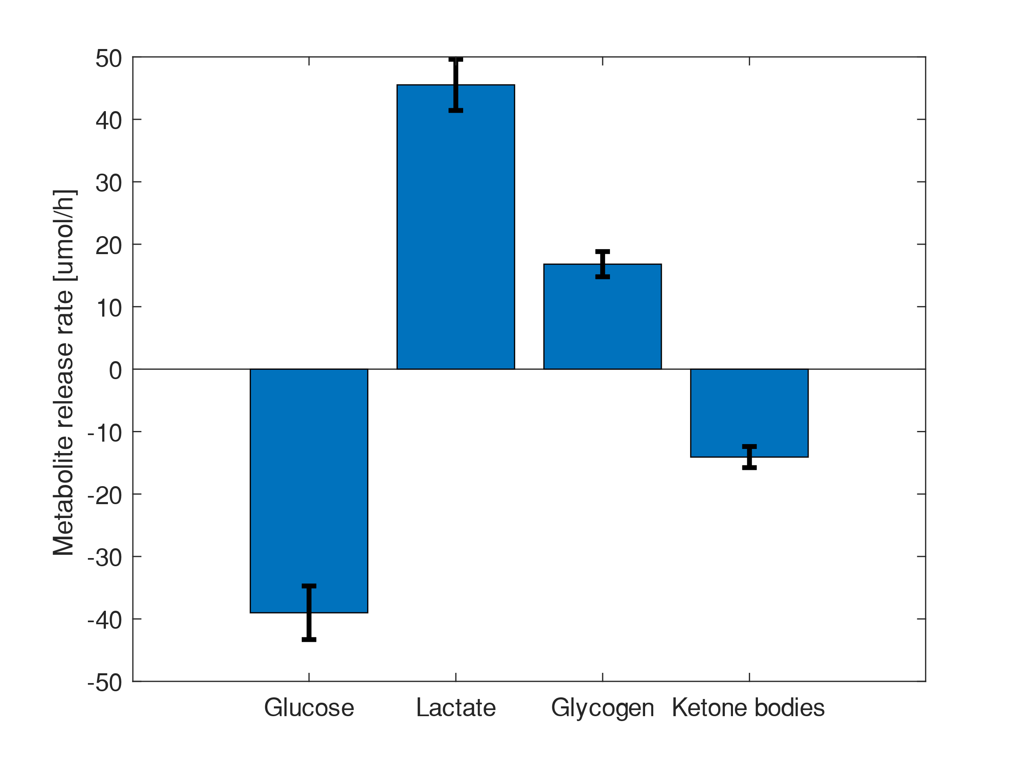
MID Data
Uptake/release Data

Slide 36
[U-¹³C] Glucose
[U-¹³C] Lactate

Slide 37
Antoniewicz, M. R. (2018) ‘A guide to 13C metabolic flux analysis for the cancer biologist’, Experimental & Molecular Medicine, 50(4), p. 19. doi: 10.1038/s12276-018-0060-y.
Antoniewicz, M. R., Kelleher, J. K. and Stephanopoulos, G. (2006) ‘Determination of confidence intervals of metabolic fluxes estimated from stable isotope measurements.’, Metabolic engineering, 8(4), pp. 324–37. doi: 10.1016/j.ymben.2006.01.004.
Antoniewicz, M. R., Kelleher, J. K. and Stephanopoulos, G. (2007) ‘Elementary metabolite units (EMU): a novel framework for modeling isotopic distributions.’, Metabolic engineering, 9(1), pp. 68–86. doi: 10.1016/j.ymben.2006.09.001.
Buescher, J. M. et al. (2015) ‘A roadmap for interpreting 13 C metabolite labeling patterns from cells’, Current Opinion in Biotechnology, 34, pp. 189–201. doi: 10.1016/j.copbio.2015.02.003.
Dai, Z. and Locasale, J. W. (2016) ‘Understanding metabolism with flux analysis: From theory to application’, Metabolic Engineering, 43, pp. 94–102. doi: 10.1016/j.ymben.2016.09.005.
Shupletsov, M. S. et al. (2014) ‘OpenFLUX2: 13C-MFA modeling software package adjusted for the comprehensive analysis of single and parallel labeling experiments’, Microbial Cell Factories, 13(1), p. 152. doi: 10.1186/s12934-014-0152-x.

